Slide 1

Twine: A Unified Cluster Management System for Shared Infrastructure
Chunqiang Tang, Kenny Yu*, Kaushik Veeraraghavan, Jonathan Kaldor,
Scott Michelson, Thawan Kooburat, Aravind Anbudurai, Matthew Clark, Kabir Gogia, Long Cheng, Ben Christensen, Alex Gartrell, Maxim Khutornenko, Sachin Kulkarni, Marcin Pawlowski, Tuomas Pelkonen, Andre Rodrigues, Rounak Tibrewal,
Vaishnavi Venkatesan, and Peter Zhang
OSDI 2020

Slide 2
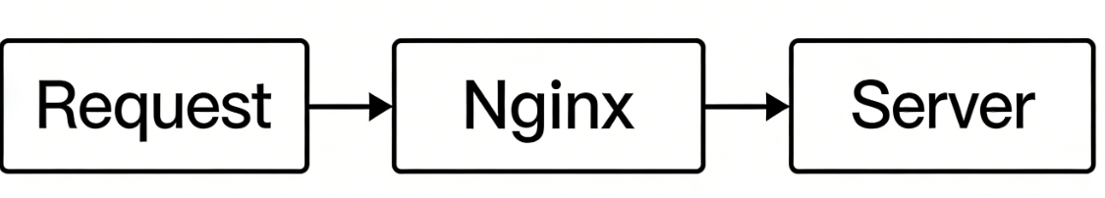
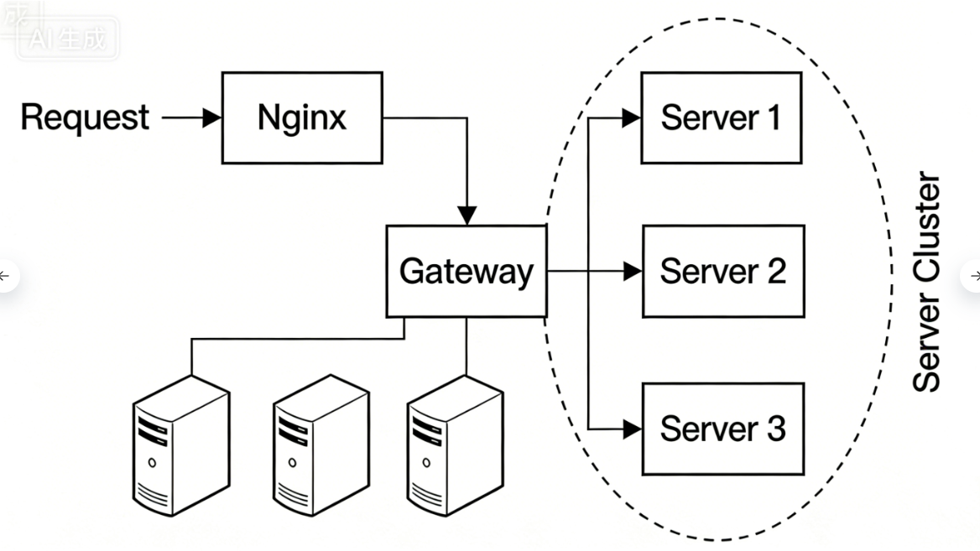
Server Cluster: A group of servers that work together as a single system for applications or services.
2

Slide 3




Data center geographic regions
Luleå, Sweden
Papillion, NE
Altoona, IA DeKalb, IL
New Albany, OH Gallatin, TN Henrico, VA Forest City, NC
Newton County, GA
Odense, Denmark
Clonee, Ireland
Prineville, OR Eagle Mountain, UT
Los Lunas, NM
Fort Worth TX
Huntsville, AL
Singapore
New construction
Serving traffic
3

Slide 4
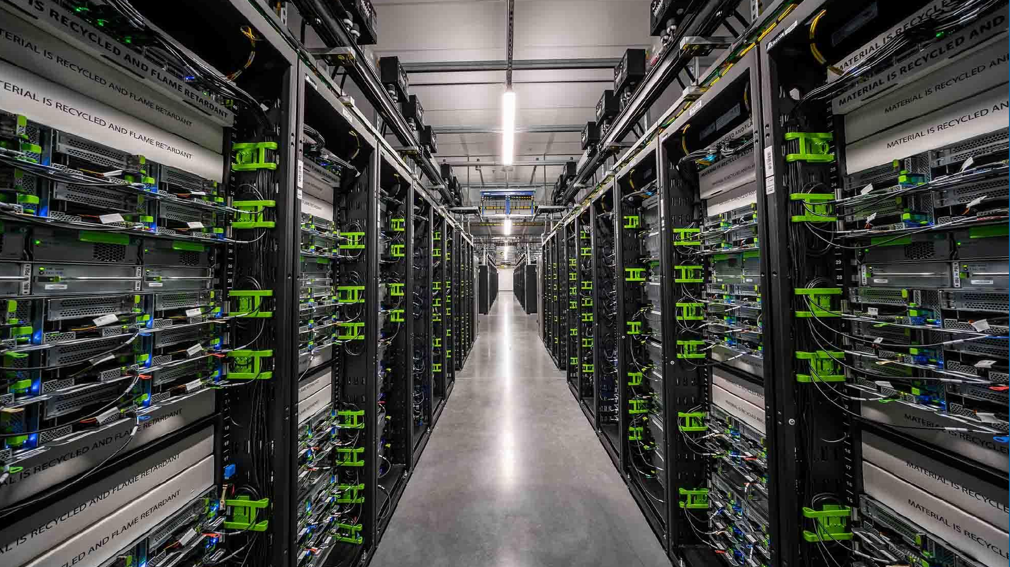





Cache
Search
Web
News Feed
Ads

Slide 5

Cluster management systems
Cache
Search
Web
_{Ads} News Feed
Why we need it?

Slide 6
What system design problems we have now?
Problem 1
Resource Isolation
Problem 2
Configuration
& Independent Lifecycle Management
Problem 3
Large Machine resource waste

Slide 7
What design decisions did Twine make differently?
Decision 1
Dynamic machine partitioning
over static clusters
Decision 2
Customization in shared infrastructure
over private pools
Decision 3
Small machines
over
big machines

Slide 8
What design decisions did Twine make differently?
Decision 1
Dynamic machine partitioning
over static clusters
Decision 2
Customization in shared infrastructure
over private pools
Decision 3
Small machines
over
big machines

Slide 9
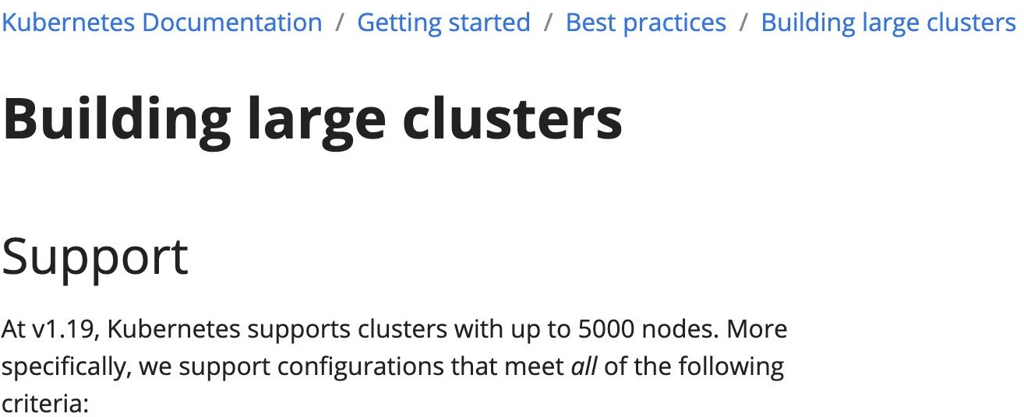
What if we used Kubernetes?

Slide 10
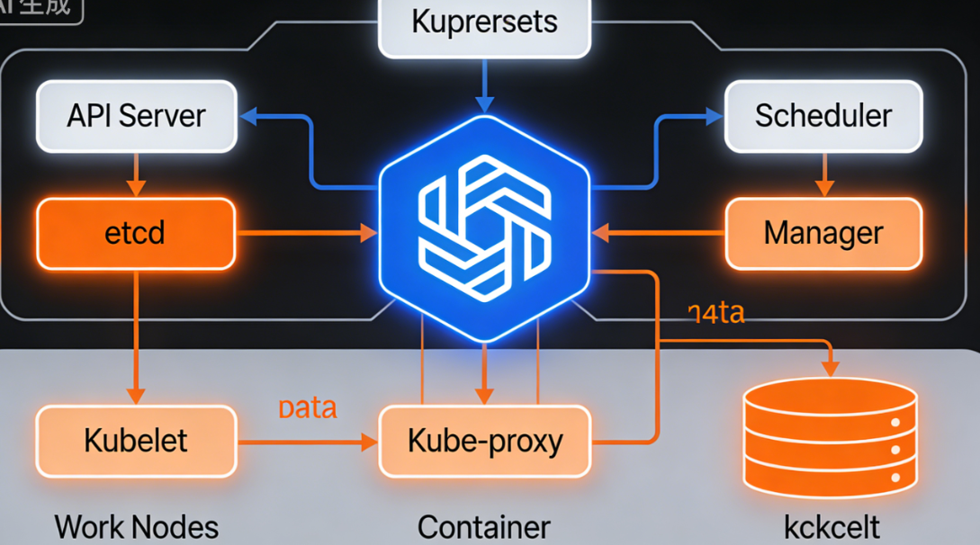
What if we used Kubernetes?
Center API needs to keep the global state and commit all action

Slide 11
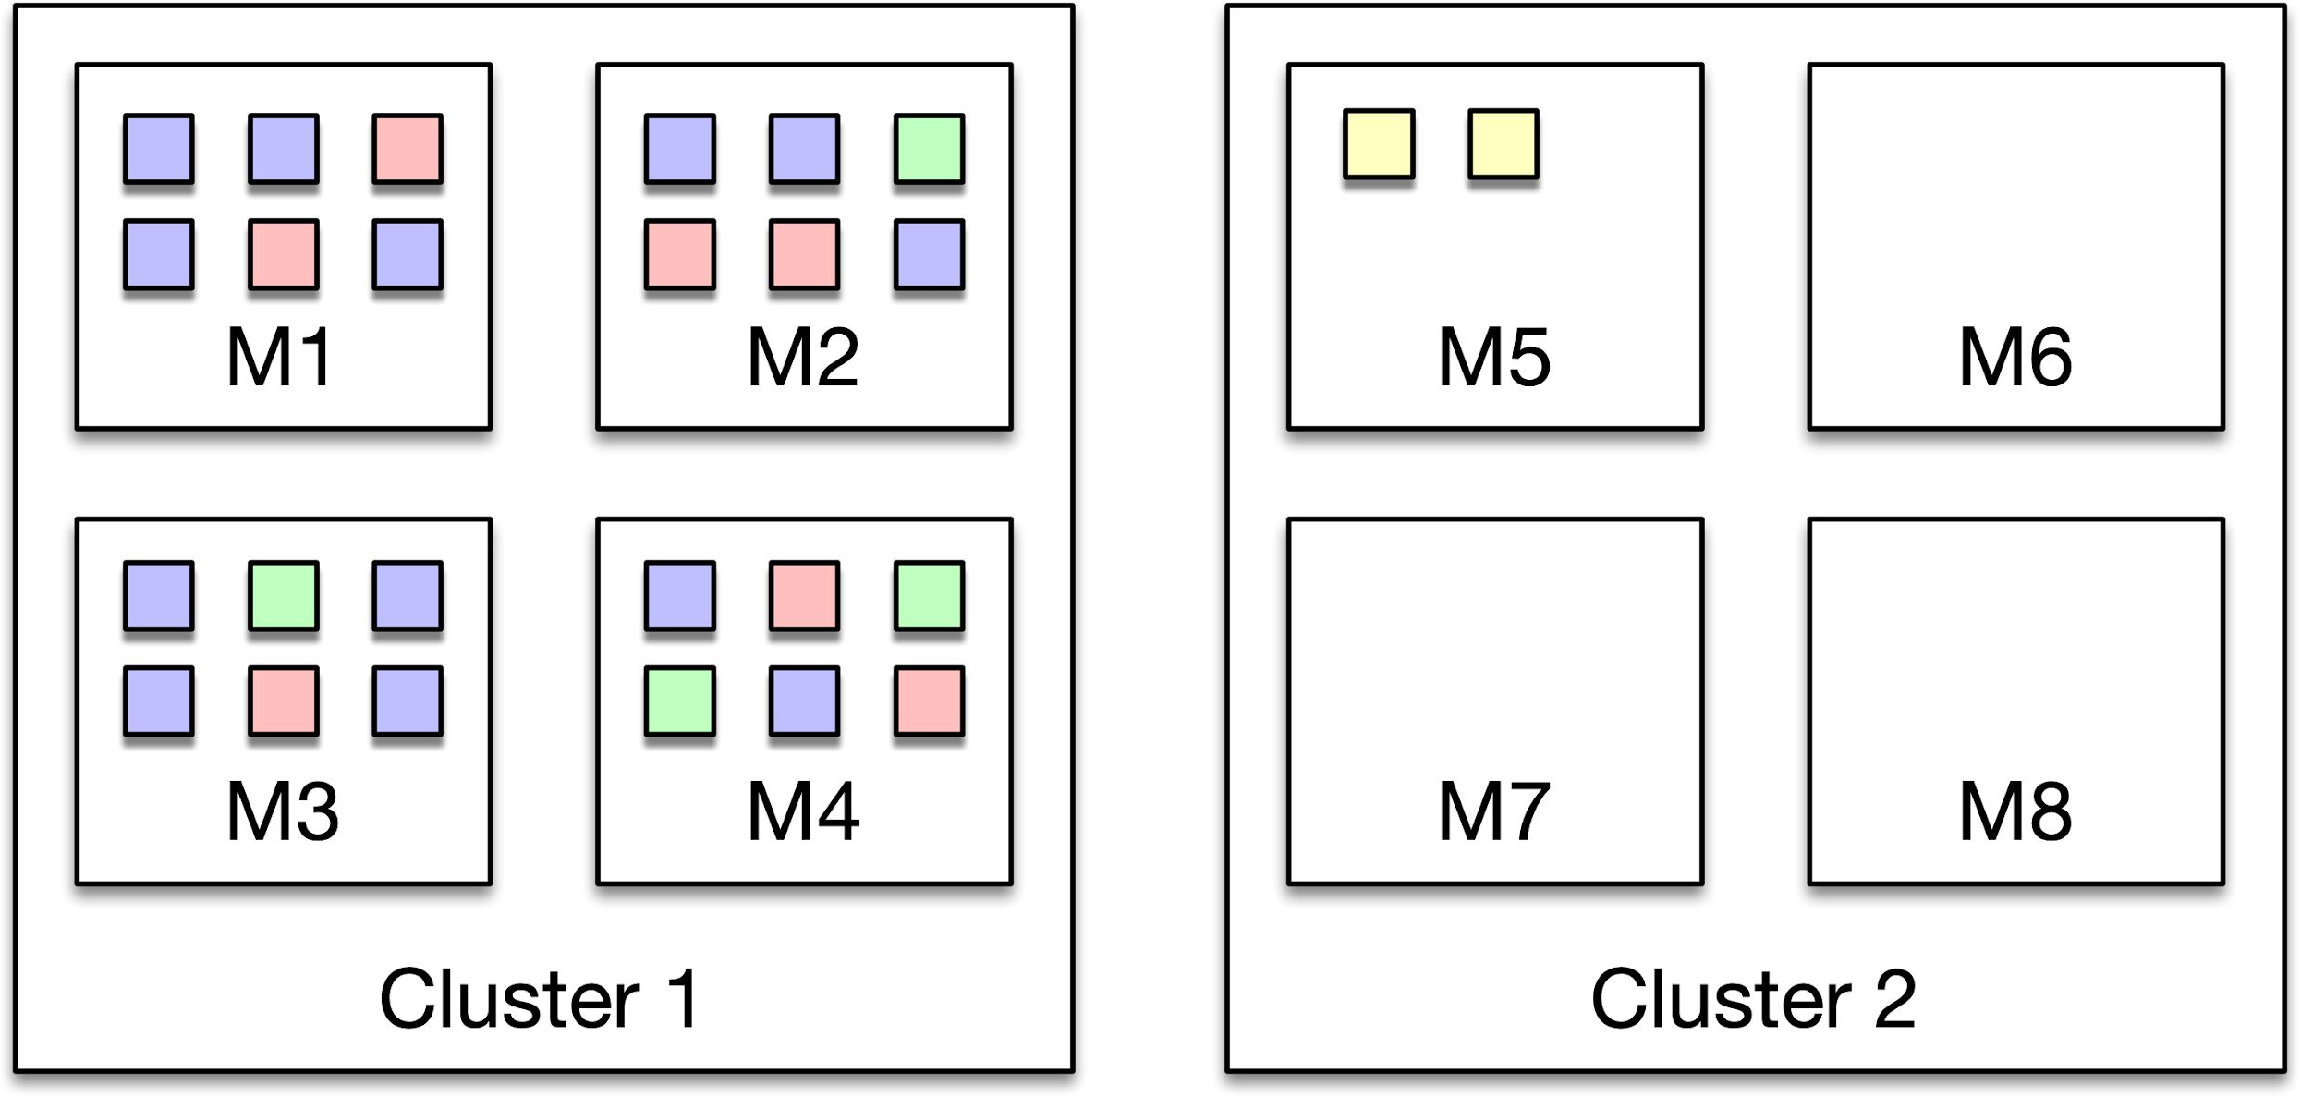
What if we used Kubernetes?

Slide 12
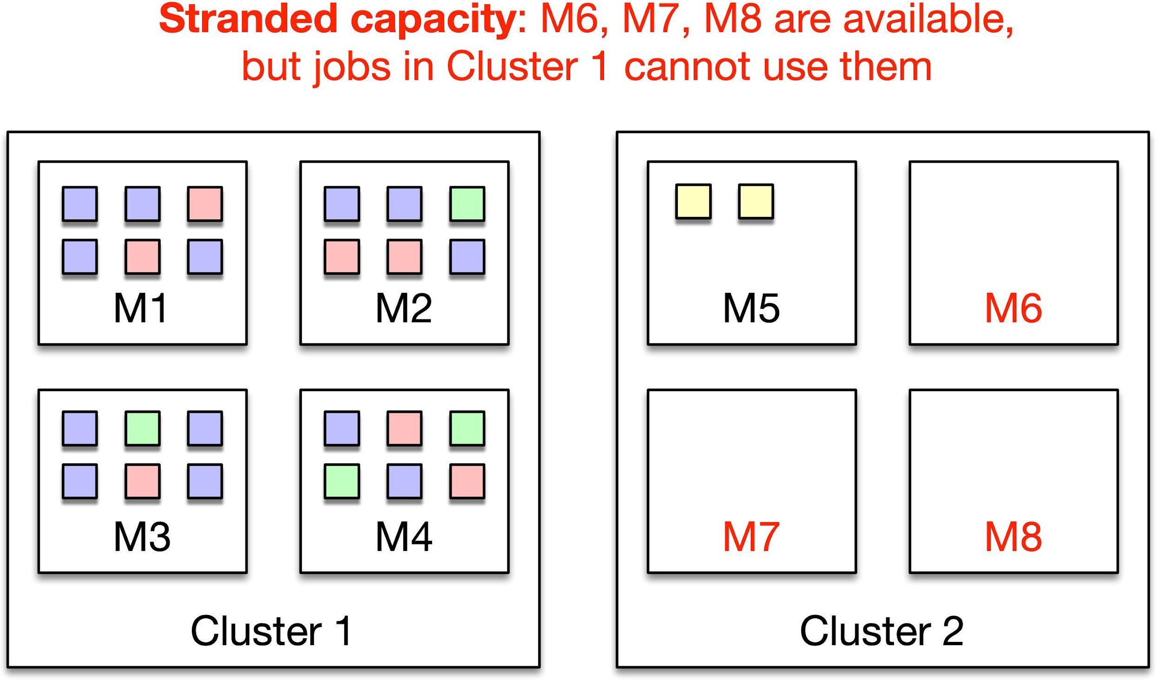
What if we used Kubernetes?
10

Slide 13

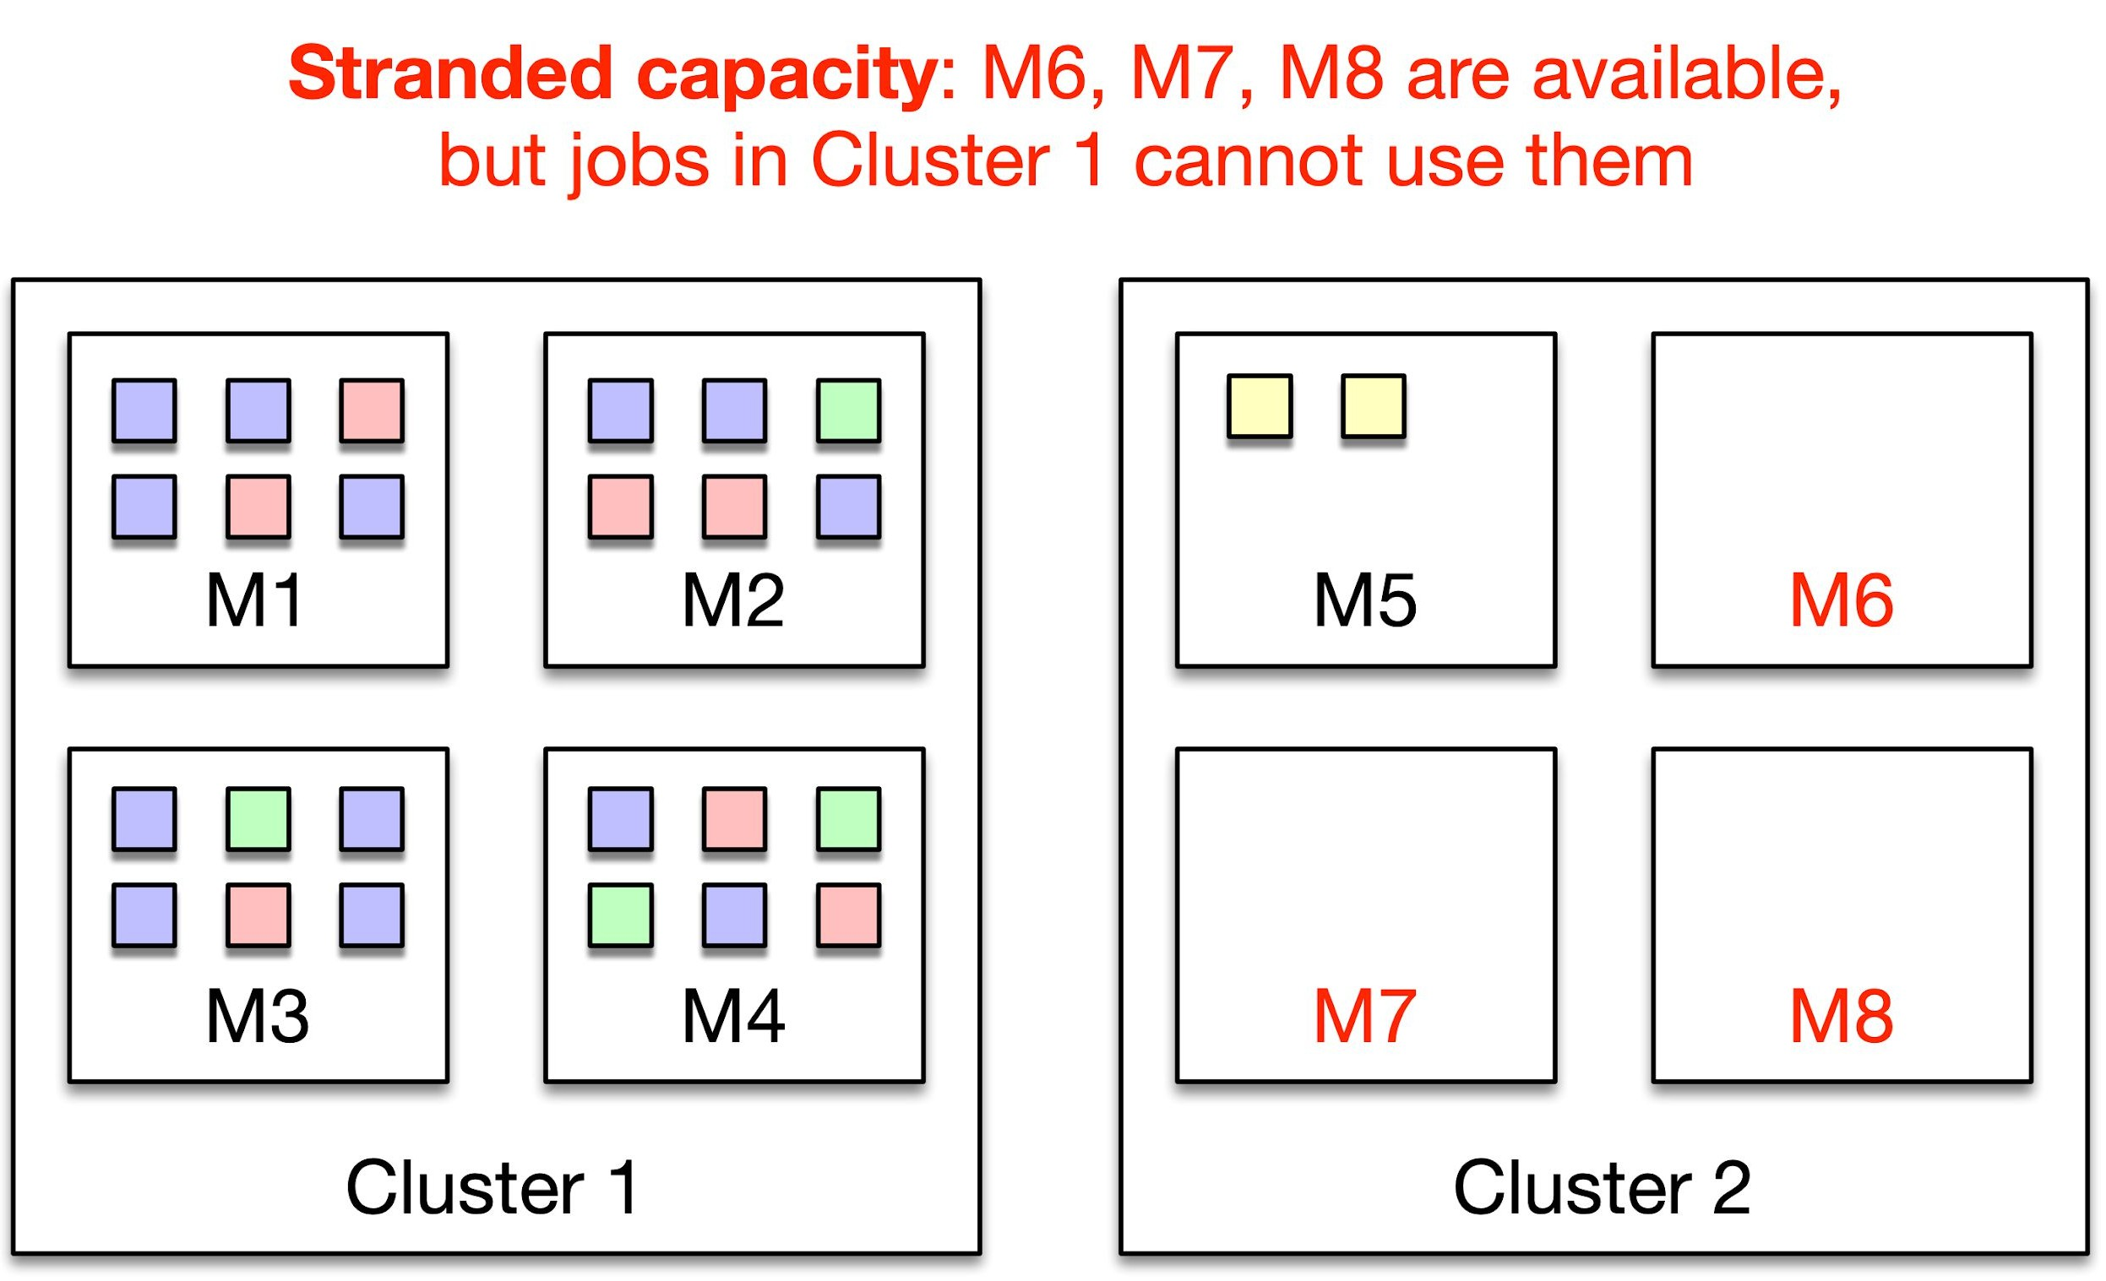
Intuition: Make machine assignment dynamic.
What if we used Kubernetes?
11

Slide 14
How does Twine avoid stranded capacity?
Entitlements：
A machine is either free or assigned to an entitlement, and it can be dynamically reassigned from one entitlement to an other.
An entitlement can consist of machines from different DCs in a region. Existing cluster management systems bind a job to a physical cluster. Twine binds a job to an entitlement.

Slide 15
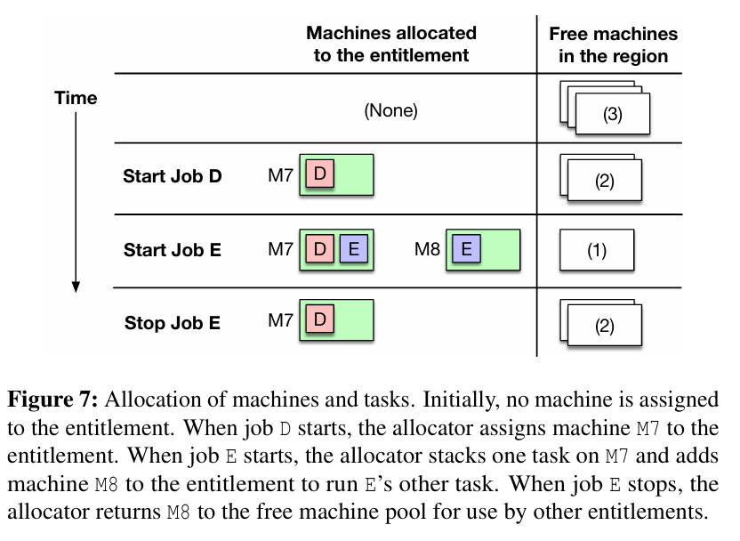
How does Twine avoid stranded capacity?
Entitlements：

Slide 16
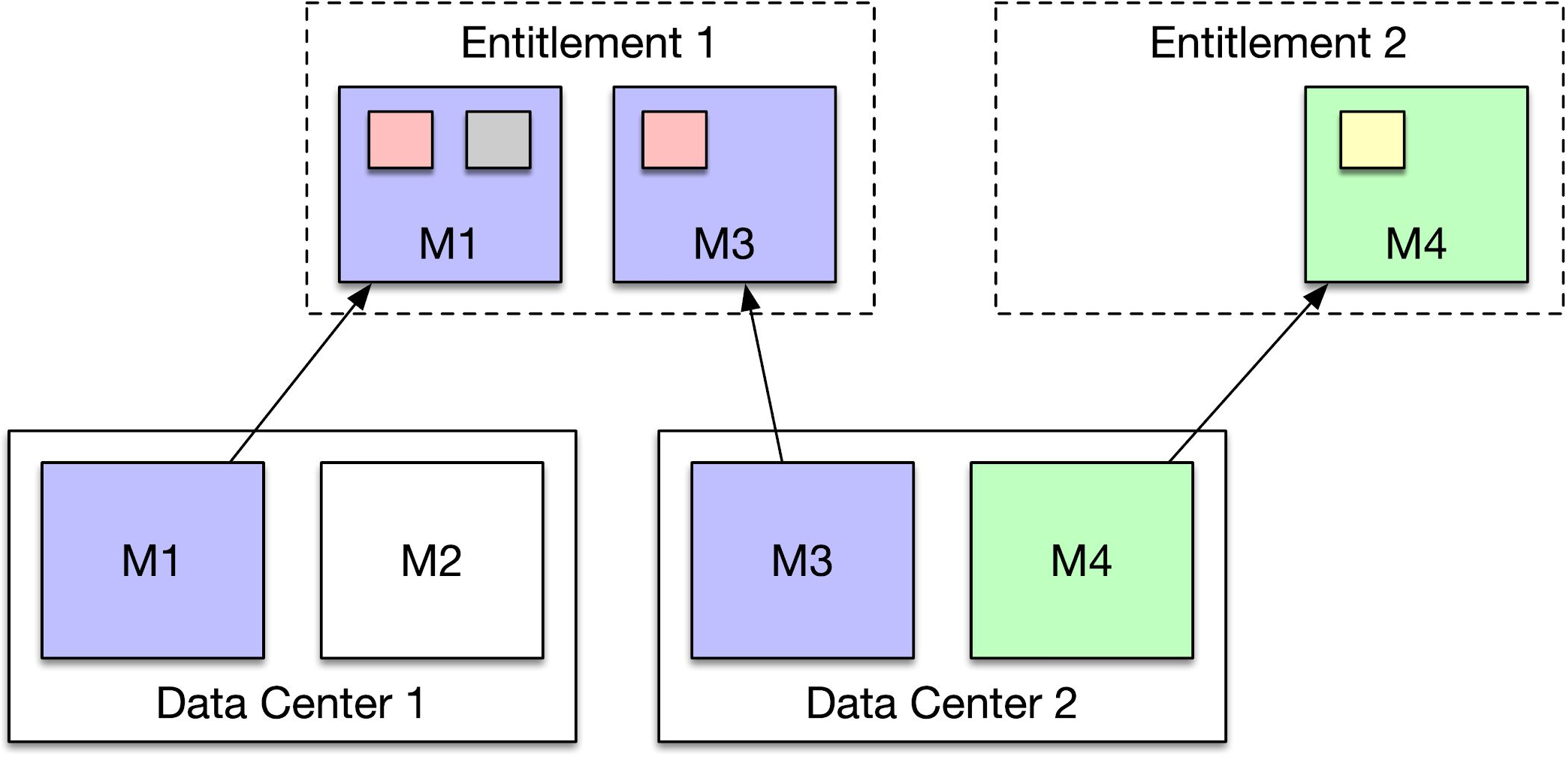
How does Twine avoid stranded capacity?
Logical isolation, not physical binding

Slide 17
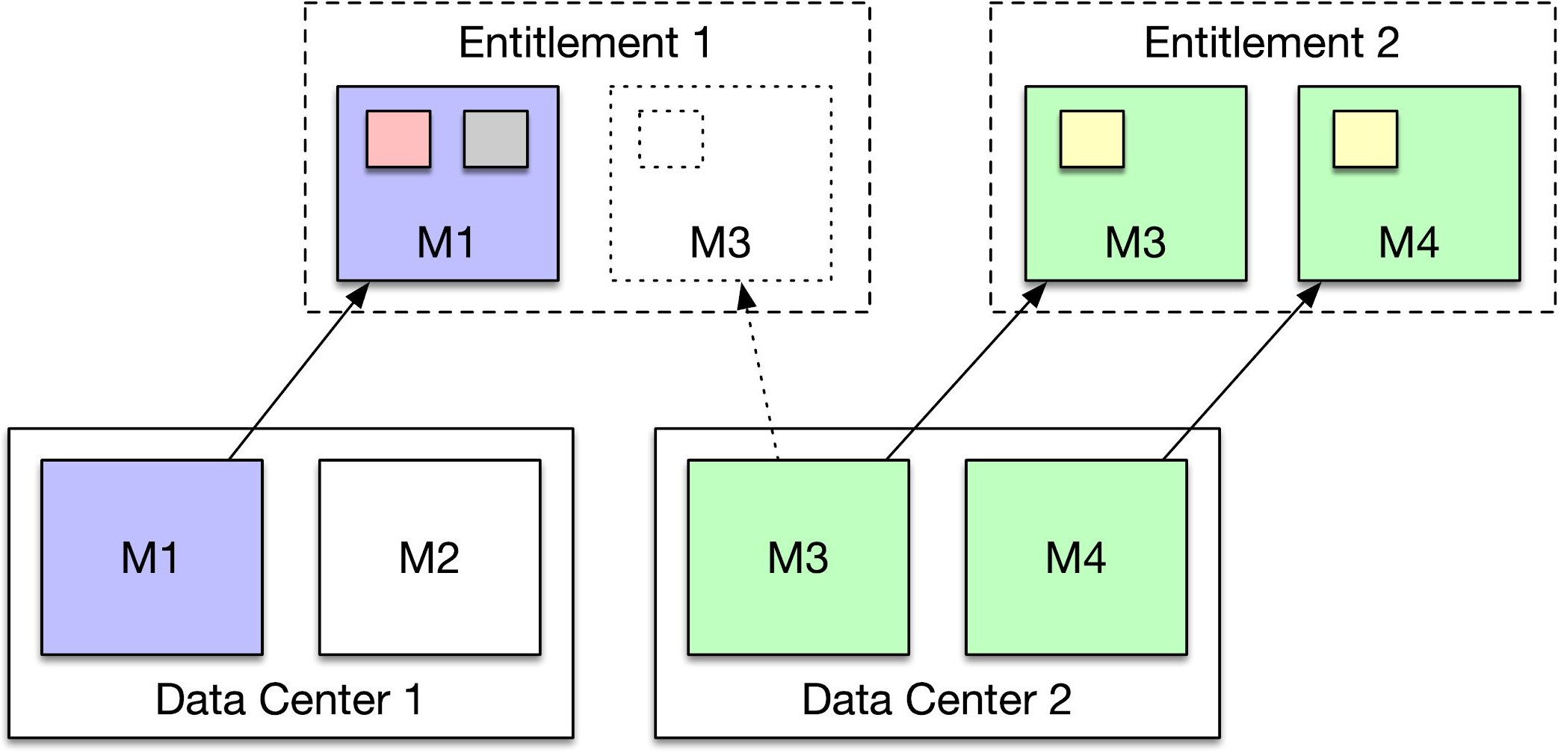
How does Twine avoid stranded capacity?
dynamic binding

Slide 18
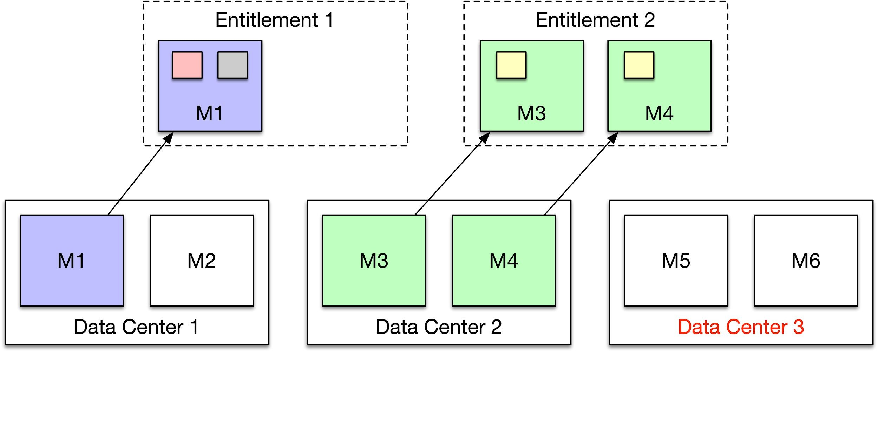
How does Twine perform wide optimization?

Slide 19
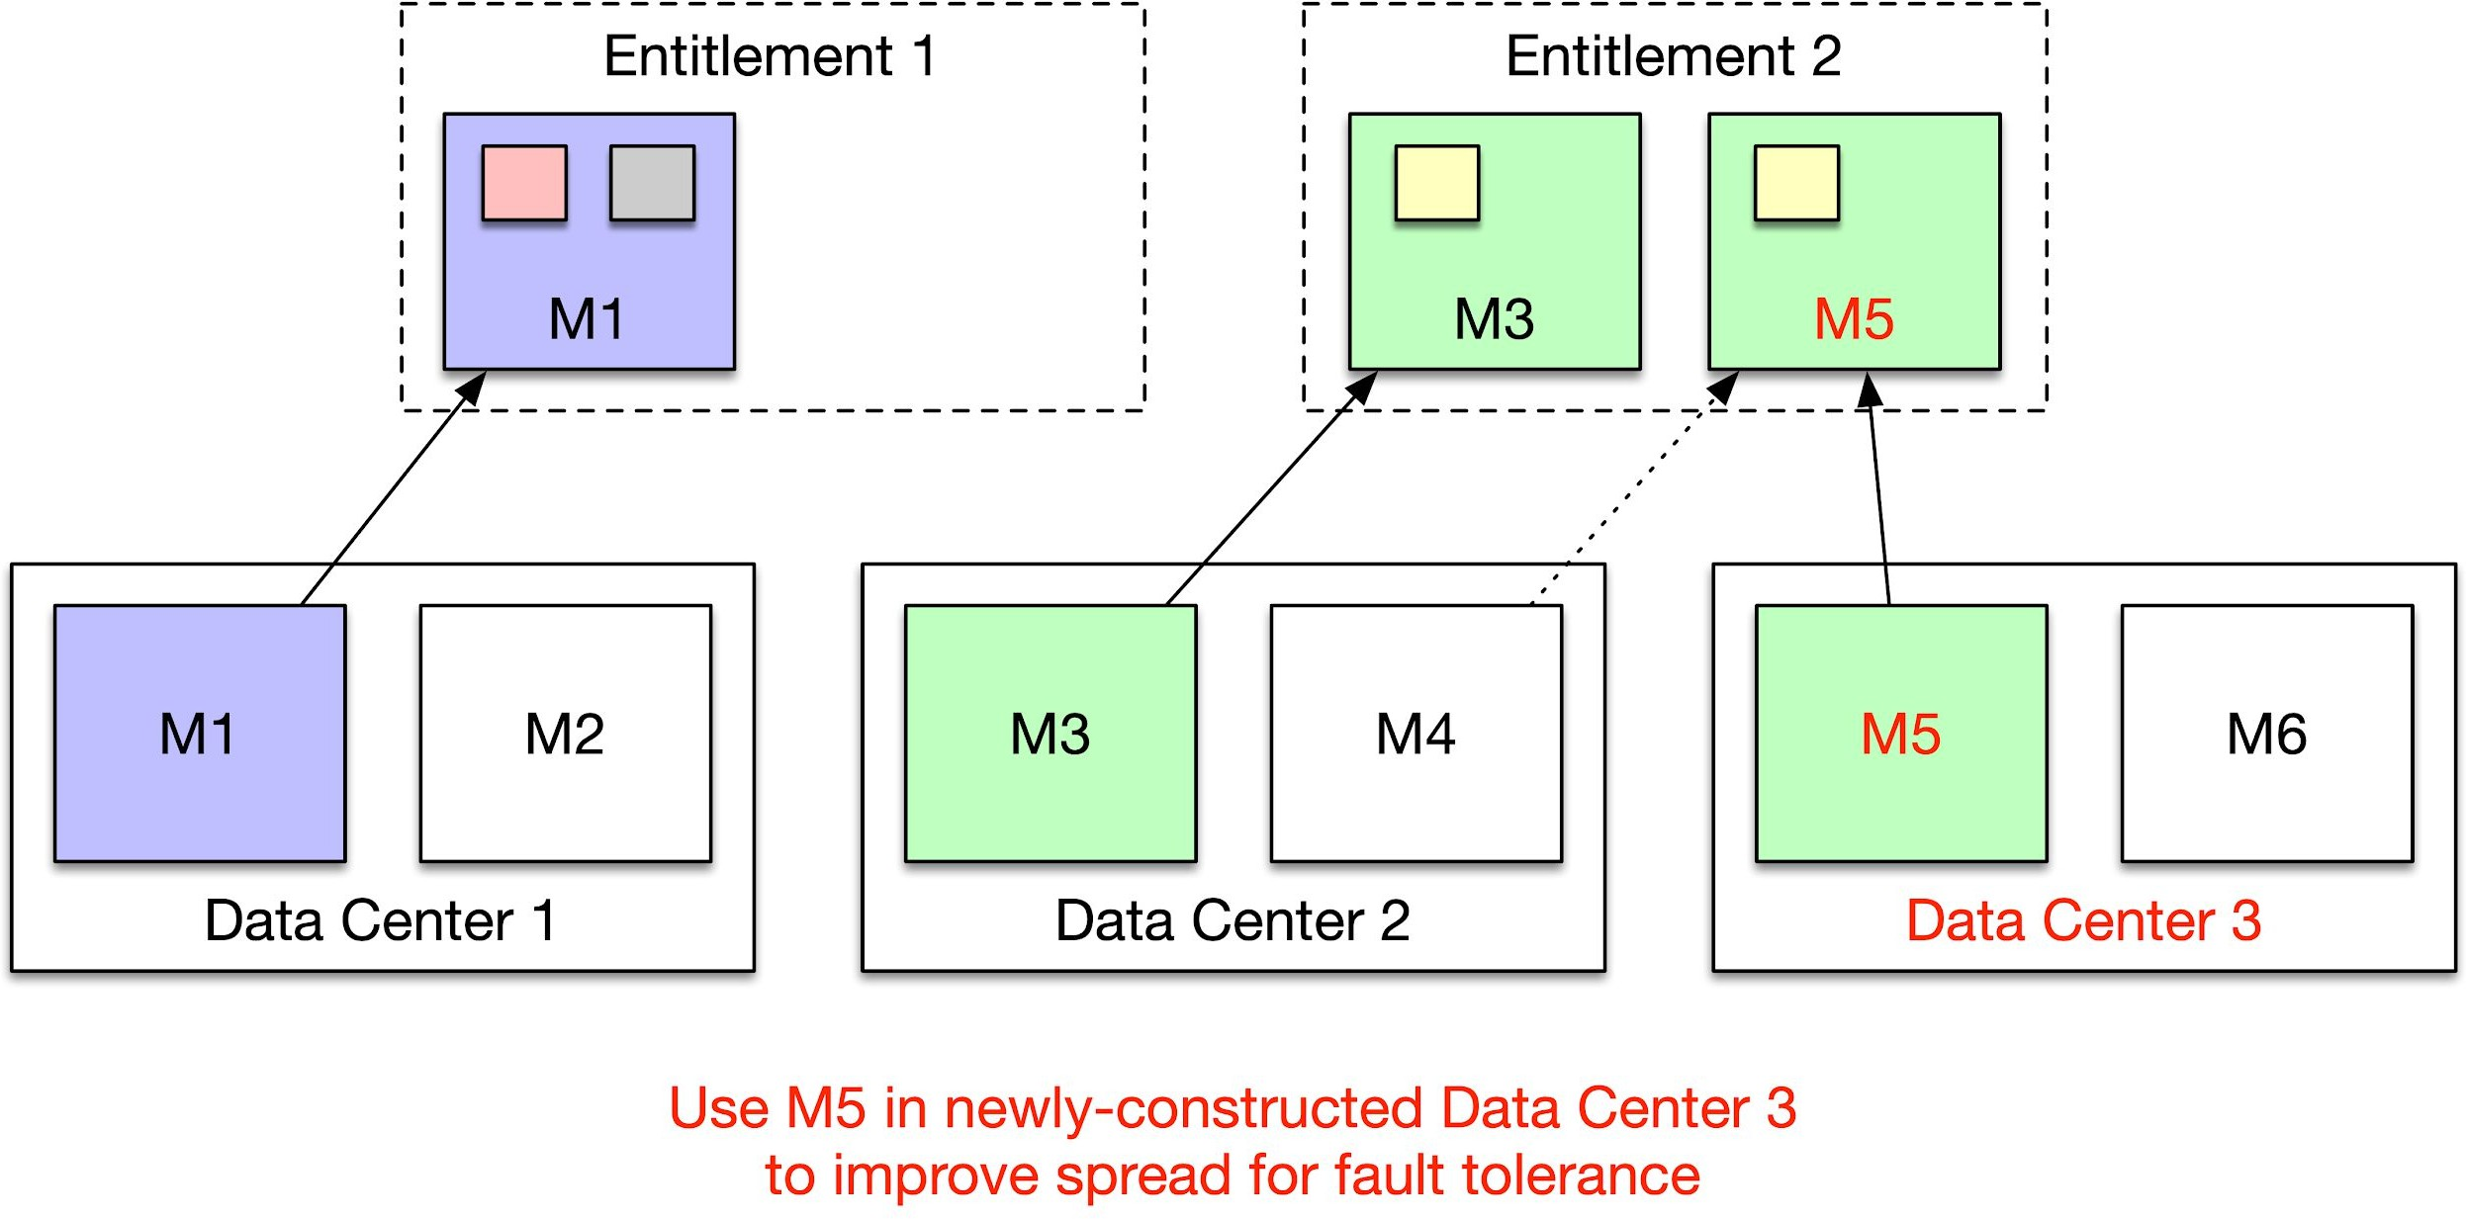
How does Twine perform wide optimization?

Slide 20
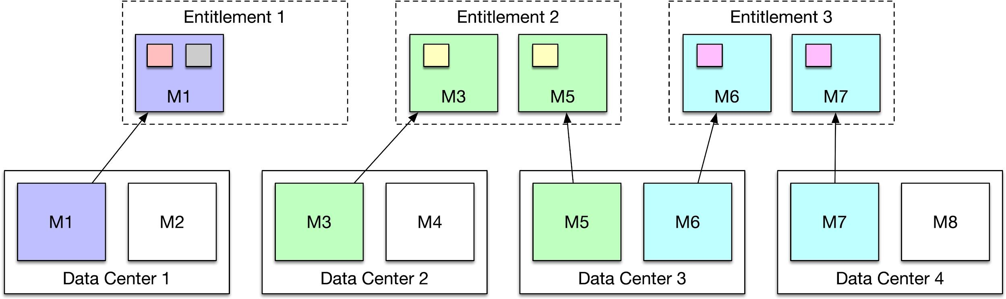
How does Twine perform wide optimization for an entire geographic region?

Slide 21
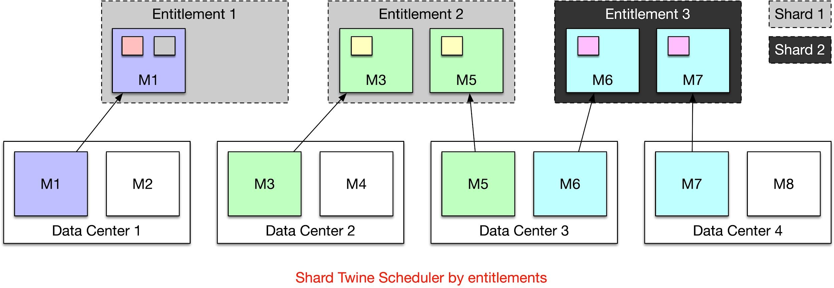
How does Twine perform fleet-wide optimization for an entire geographic region?

Slide 22
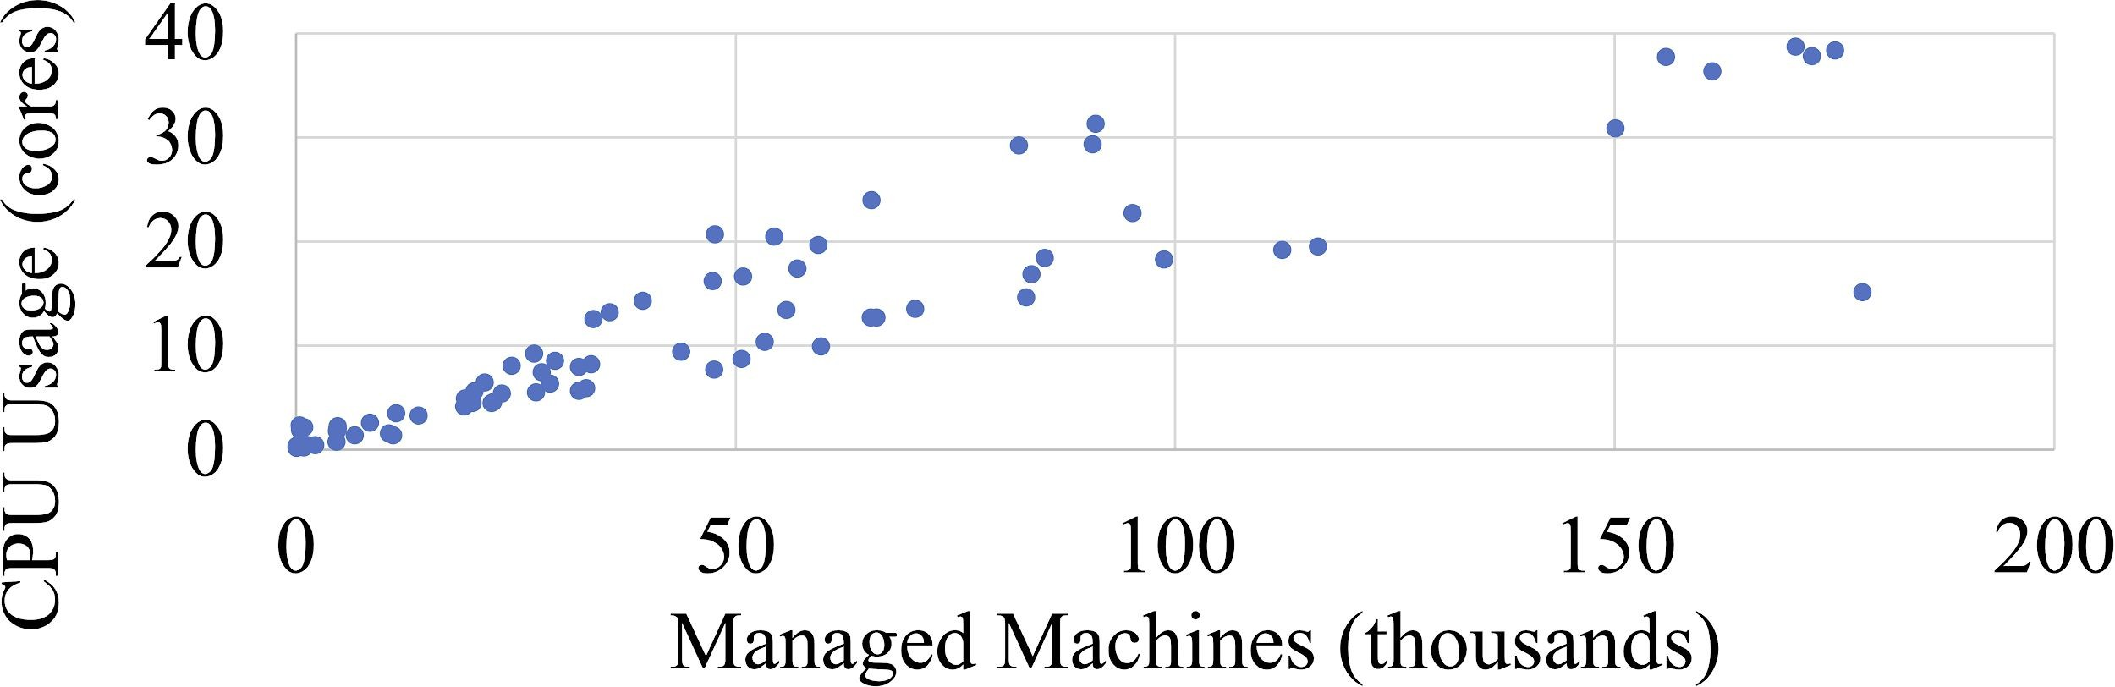
How well does the Twine scheduler scale?

Slide 23
How do we mitigate risks with 1M machines per deployment?
Control plane：
the controller of cluster
Should be a global tools
Network partitions within Application

Slide 24
What design decisions did Twine make differently?
Decision 1
Dynamic machine partitioning
over static clusters
Decision 2
Customization in shared infrastructure
over private pools
Decision 3
Small machines
over
big machines

Slide 25
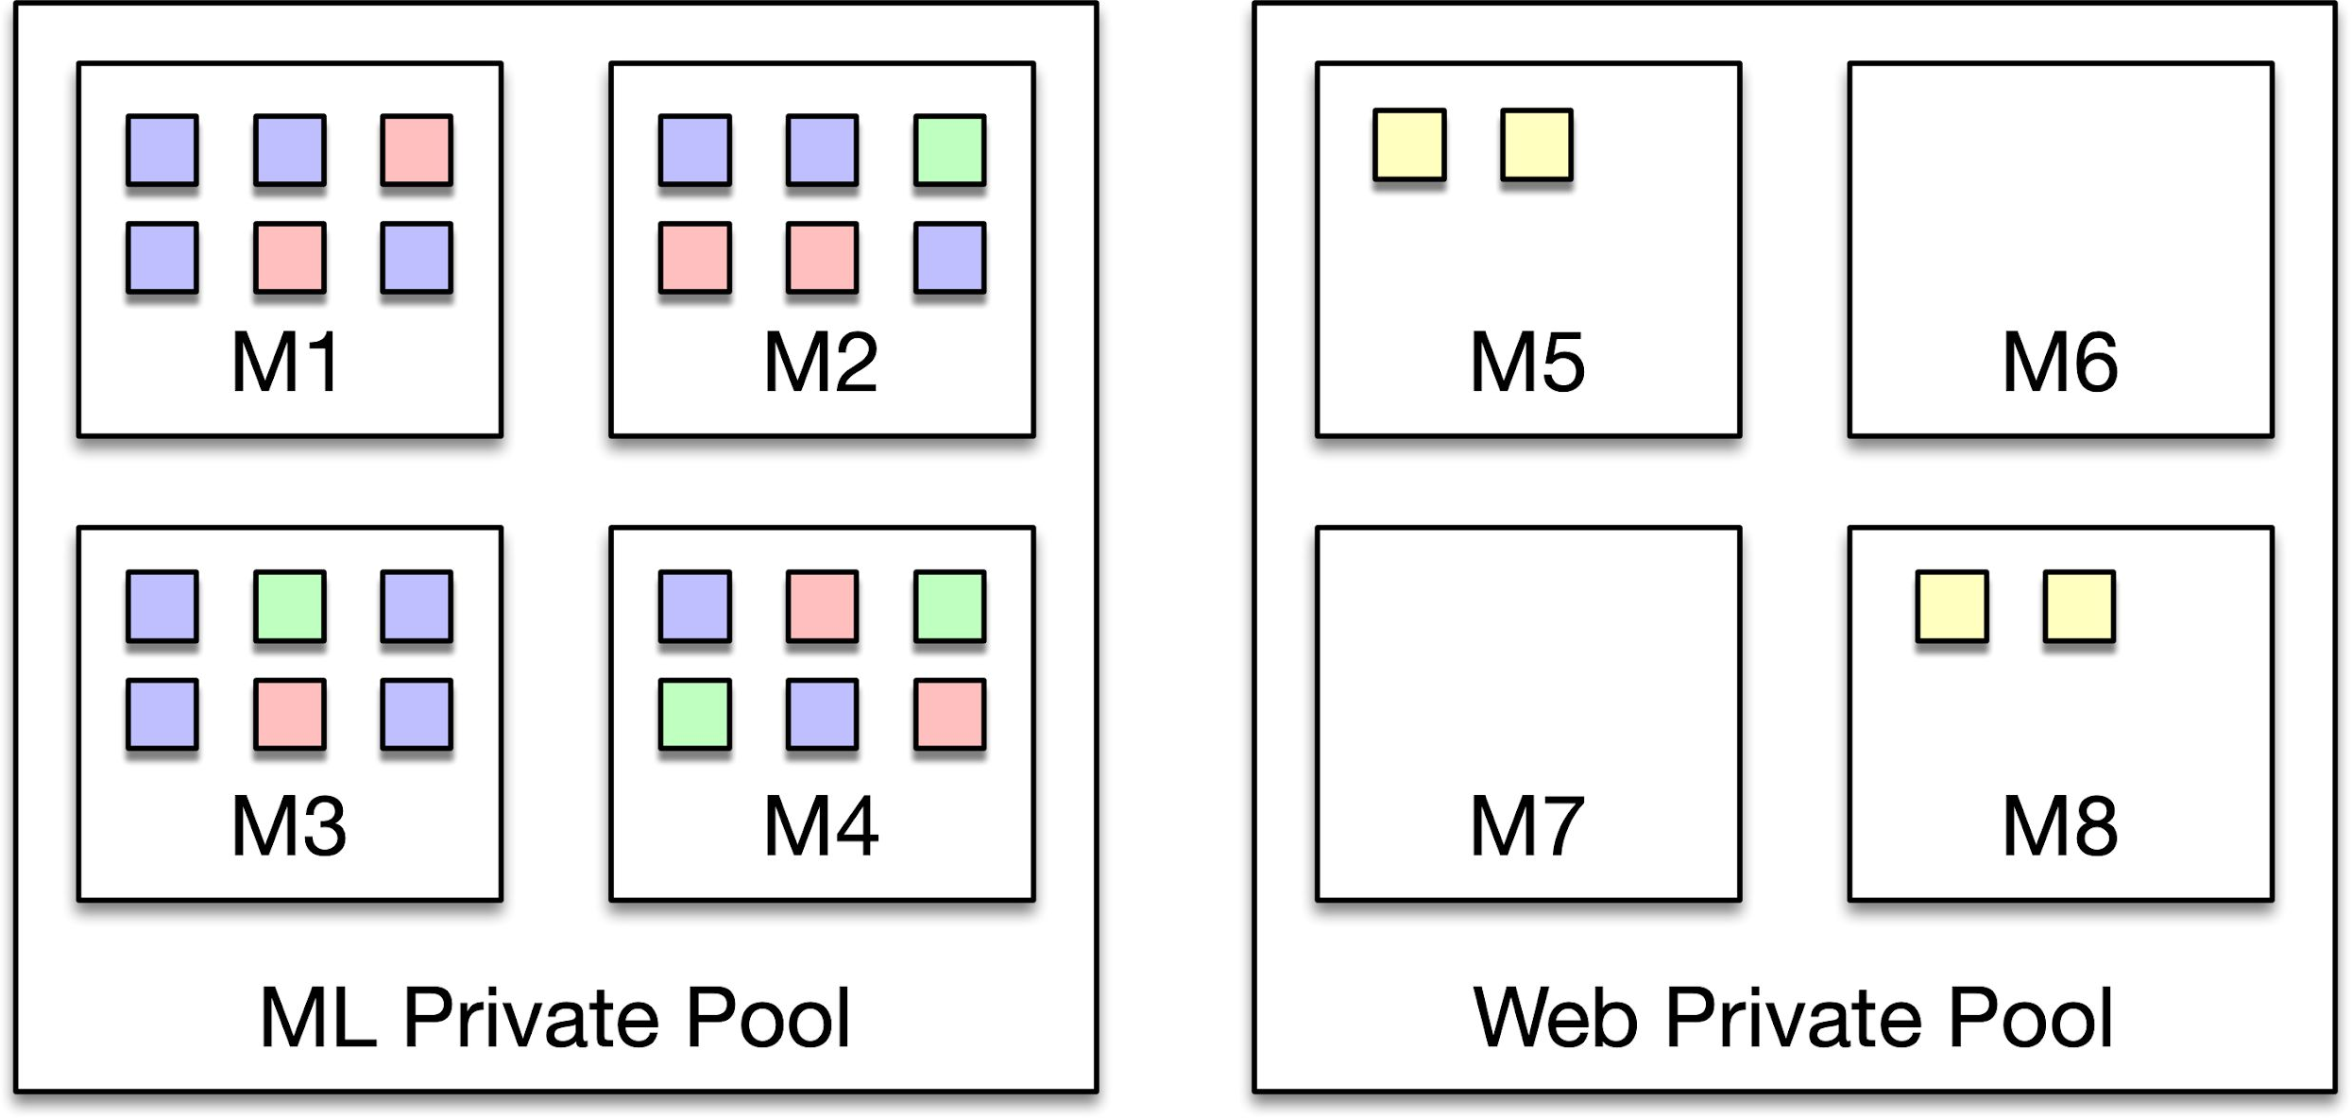
Private pools or shared infrastructure?

Slide 26
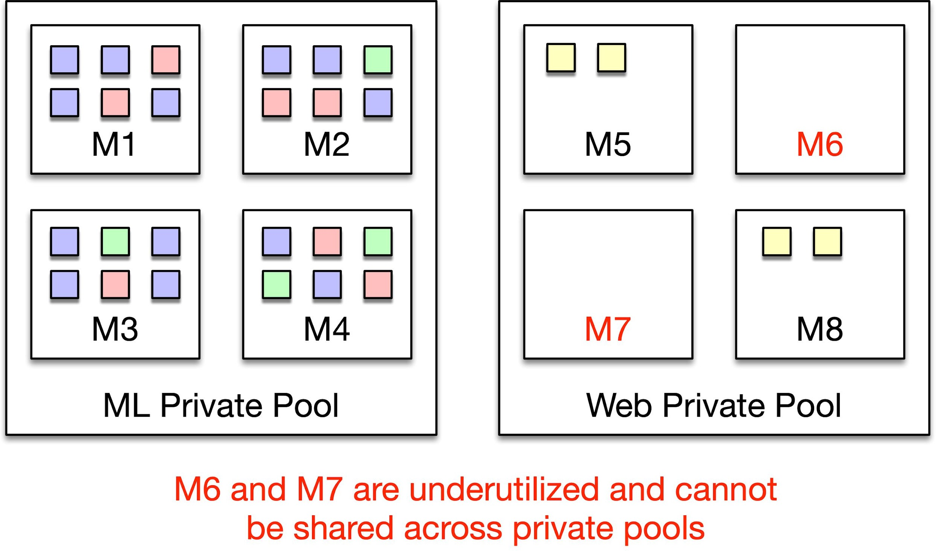
Private pools or shared infrastructure?

Slide 27
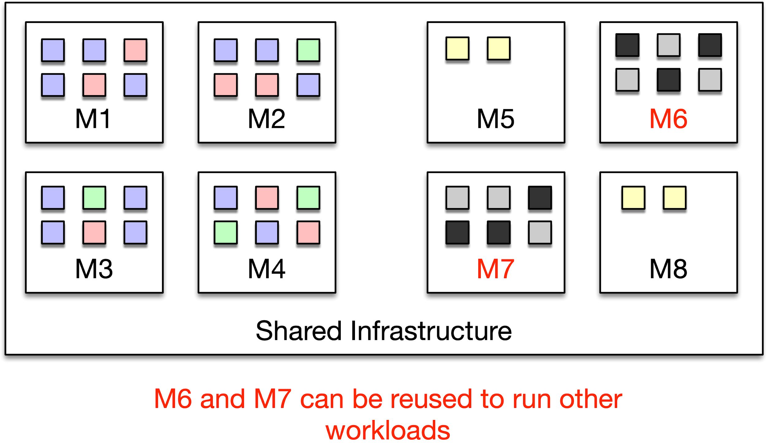
Private pools or shared infrastructure?

Slide 28
What are the challenges with supporting shared infrastructure?
Challenge 1
Cluster configuration is uniform

Slide 29
What is host customization?
NIC settings
kernel version
CPU Turbo
file system settings (e.g., btrfs, XFS)
sysctls (e.g., huge pages, kernel scheduler settings)

Slide 30
Intuition: Dynamically reconfigure machines as needed by workloads.
What is host customization?
NIC settings kernel version ^{CPU Turbo} file system settings (e.g., btrfs, XFS)
sysctls (e.g., huge pages, kernel scheduler settings)
26

Slide 31
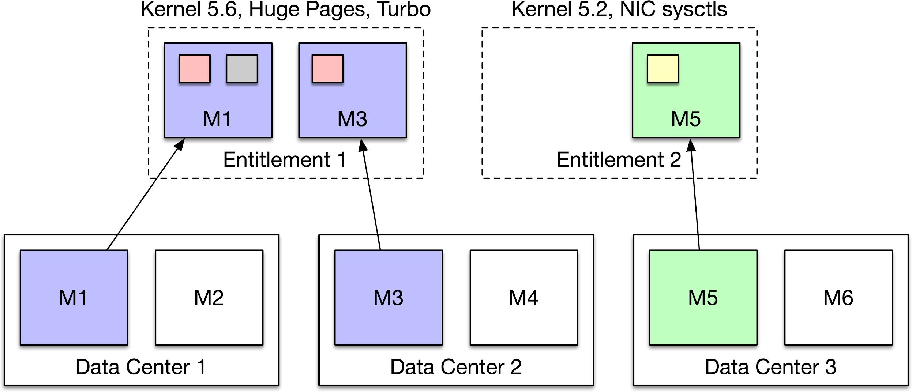
Challenge: Performance wins through host customization
31

Slide 32
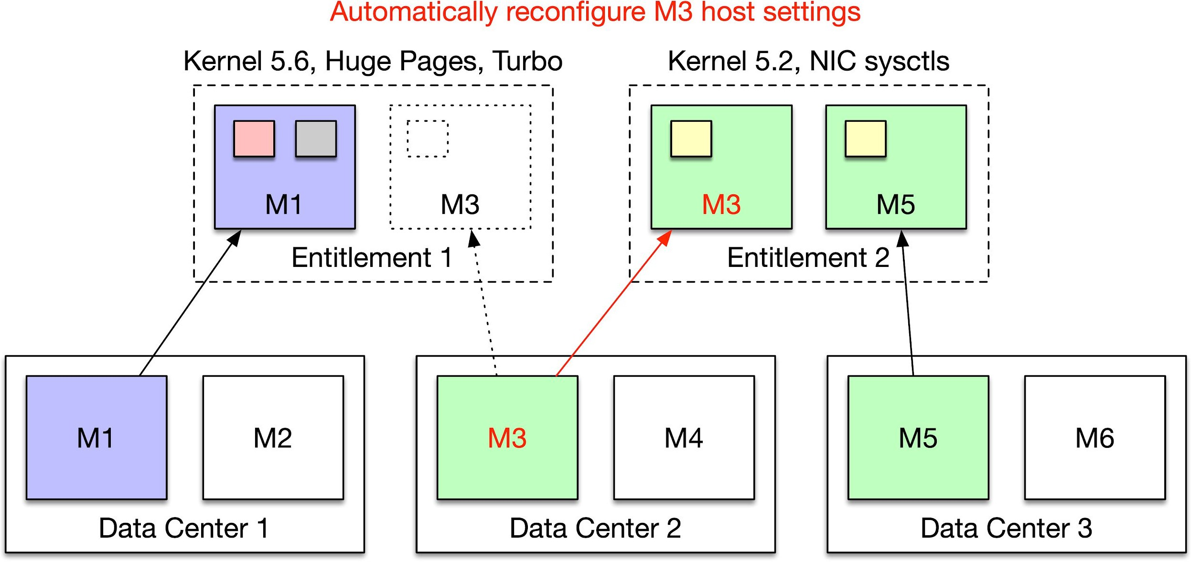
Challenge: Performance wins through host customization
32

Slide 33
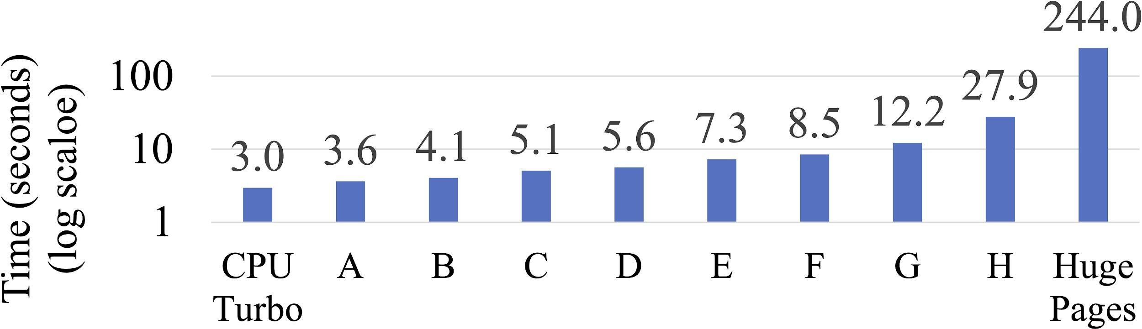
What is the overhead for host profile switches?
On average, a machine changes host profiles once every ~2 days

Slide 34
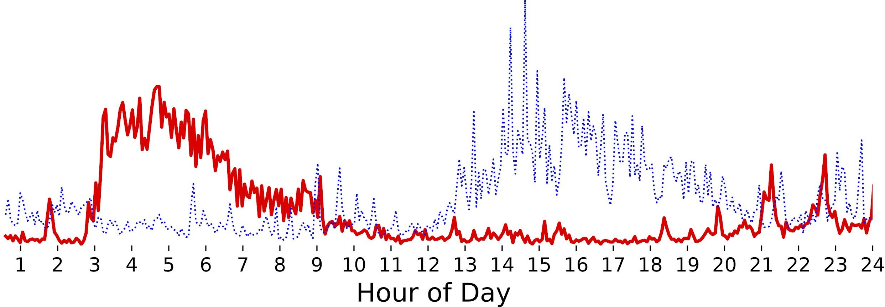


What drives host profile changes?
Change machines
non-ALM-tracking services
Change machines
ALM-tracking services

Slide 35
Shared infrastructure makes machines fungible and improves efficiency!
What drives host profile changes?
Change machines to run
non-ALM-tracking services
Change machines to run
ALM-tracking services
32

Slide 36
What are the challenges with supporting ubiquitous shared infrastructure?
Challenge 1
Approach
Host profiles
Challenge 2
Tasks are not homogenous

Slide 37
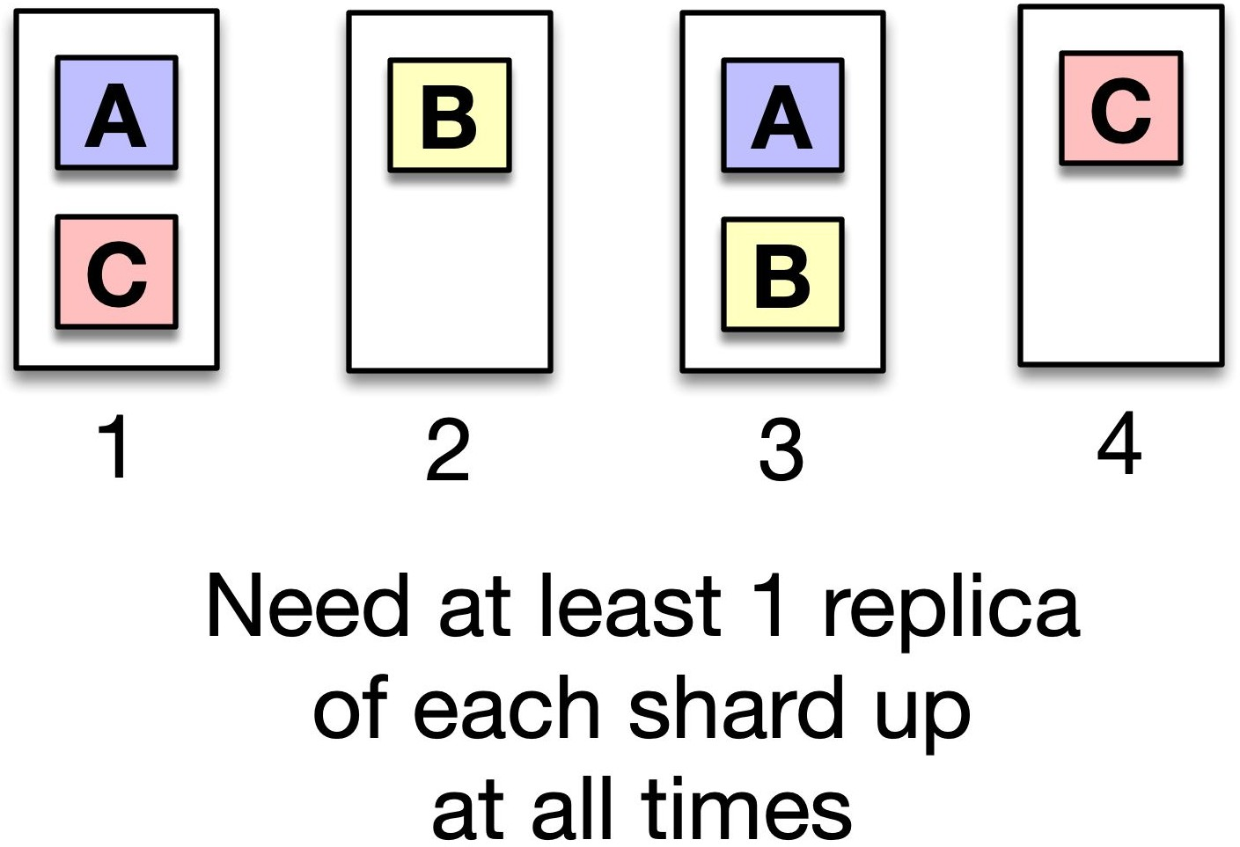
Challenge: Tasks are not homogenous

Slide 38
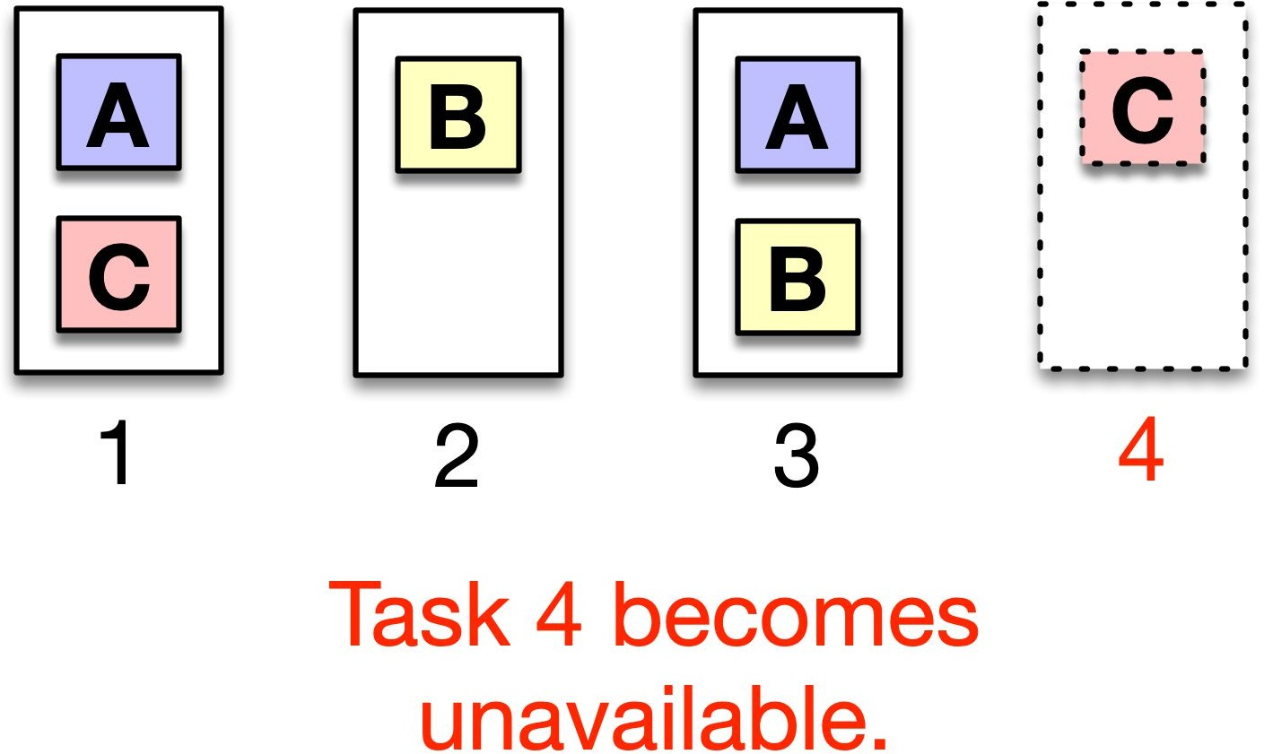
Challenge: Tasks are not homogenous

Slide 39
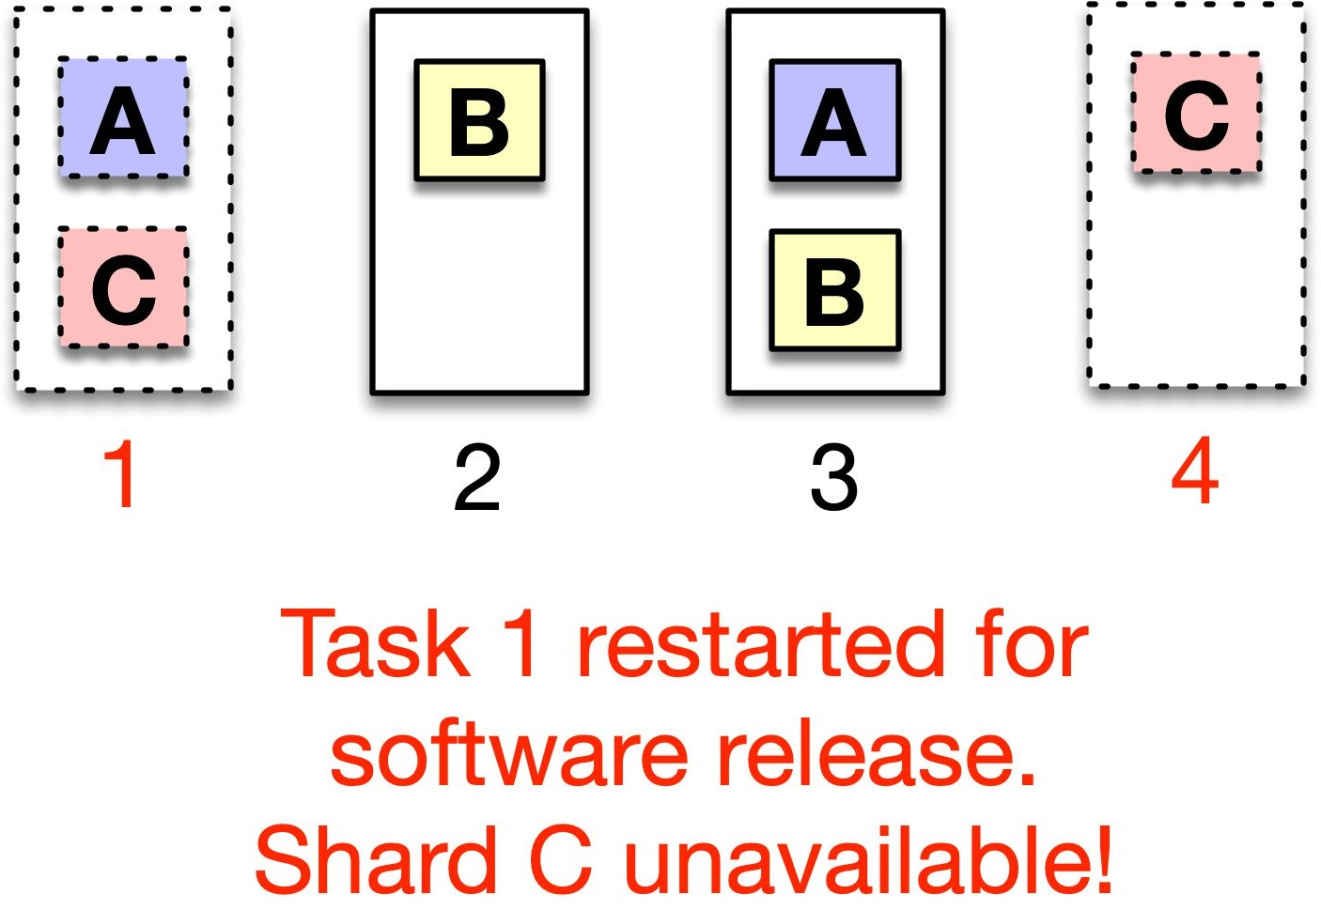
Challenge: Tasks are not homogenous

Slide 40
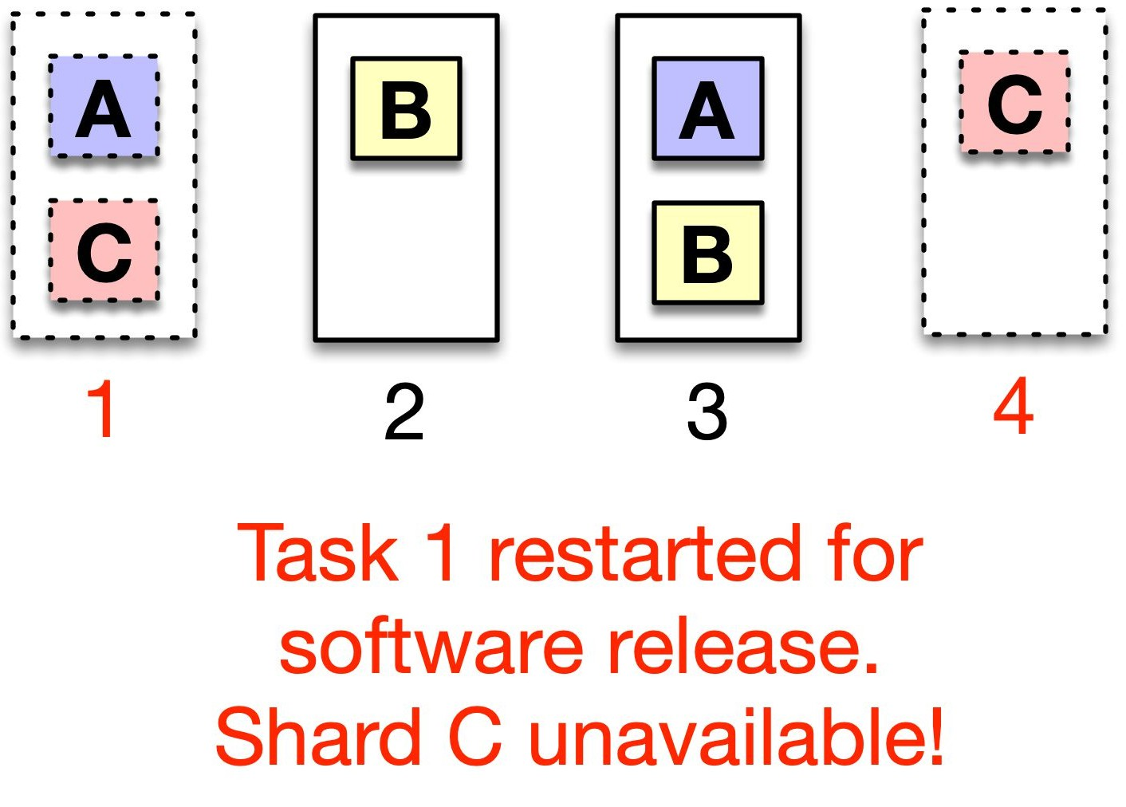
Intuition: Collaborate with applications to handle lifecycle events.
Challenge: Tasks are not homogenous
37

Slide 41
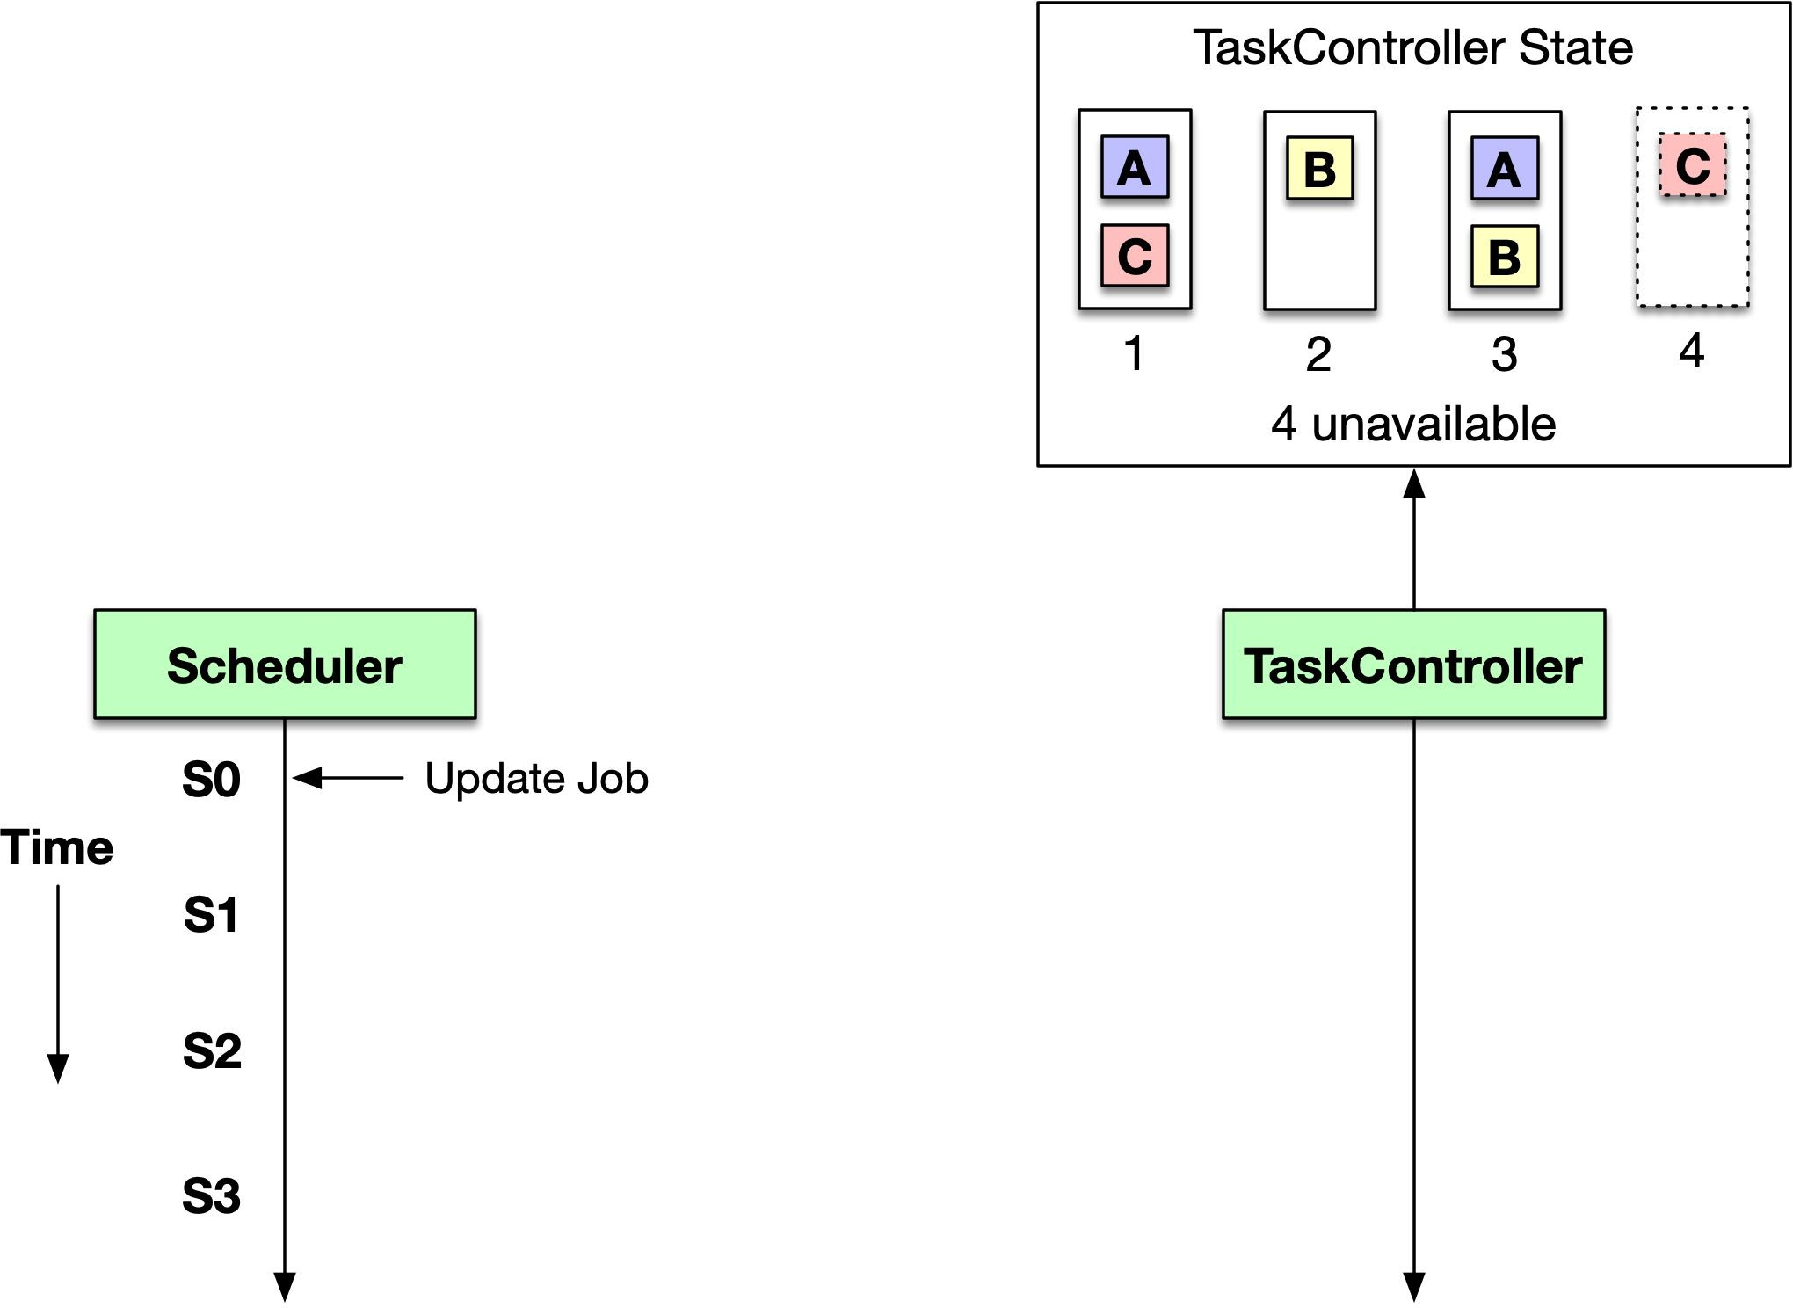
How does Twine collaborate with applications?

Slide 42
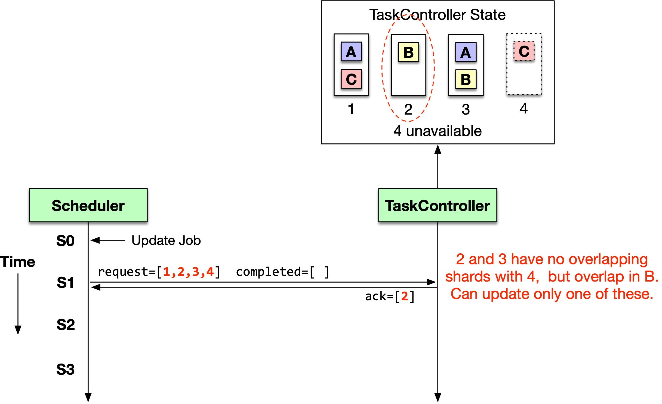
How does Twine collaborate with applications?

Slide 43
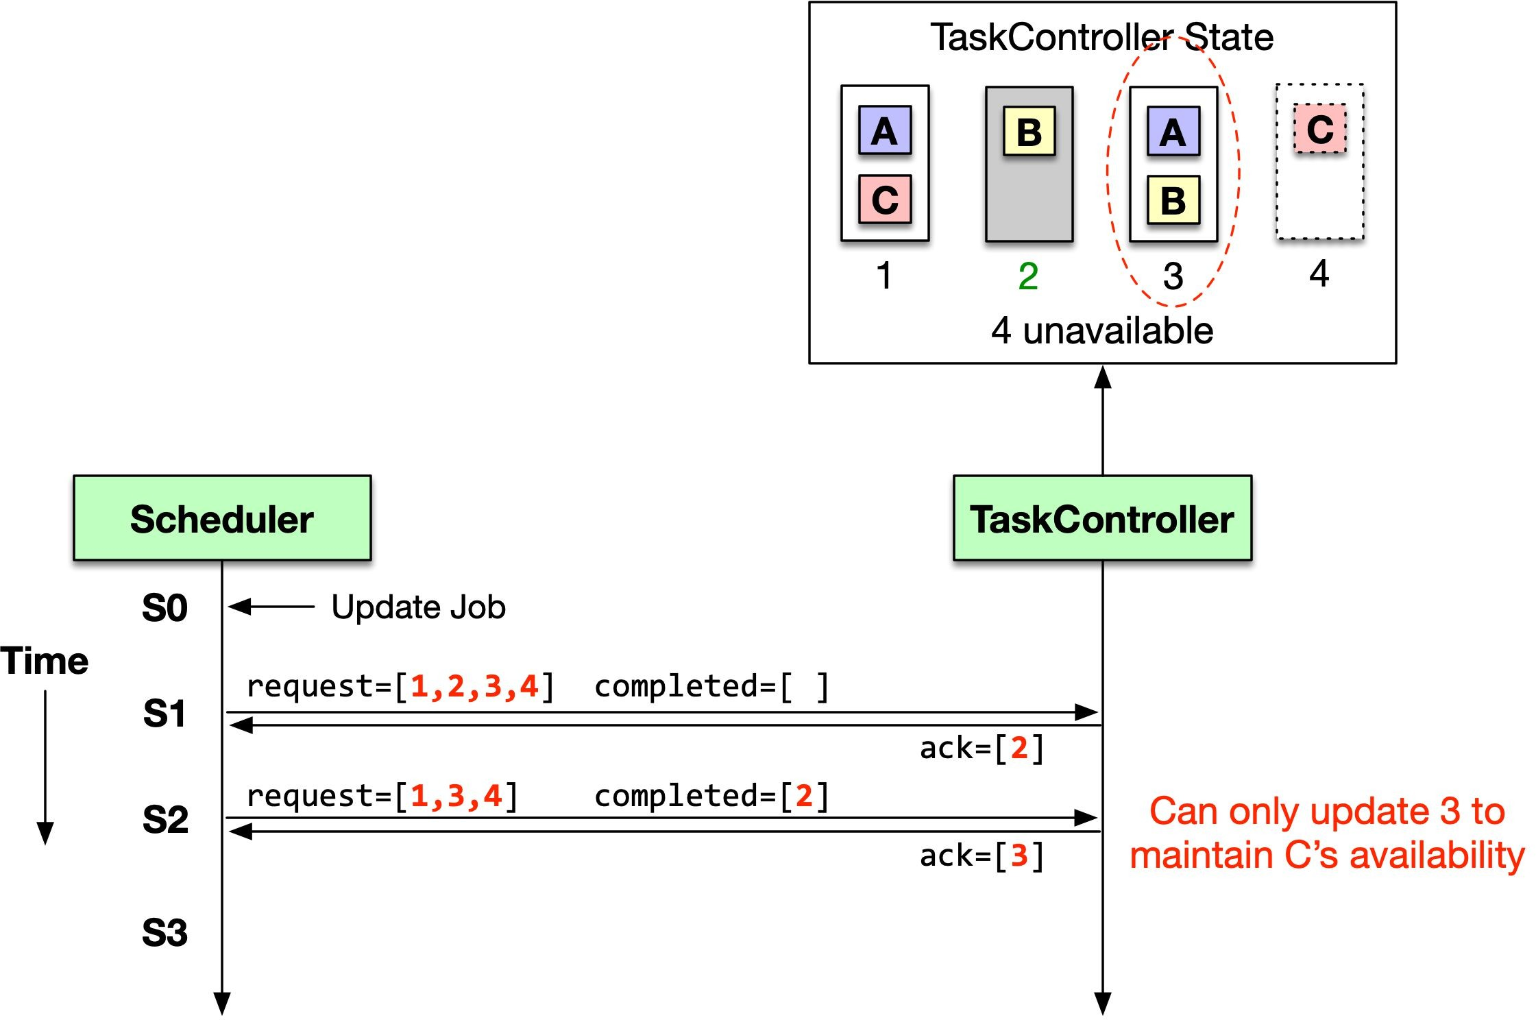
How does Twine collaborate with applications?

Slide 44
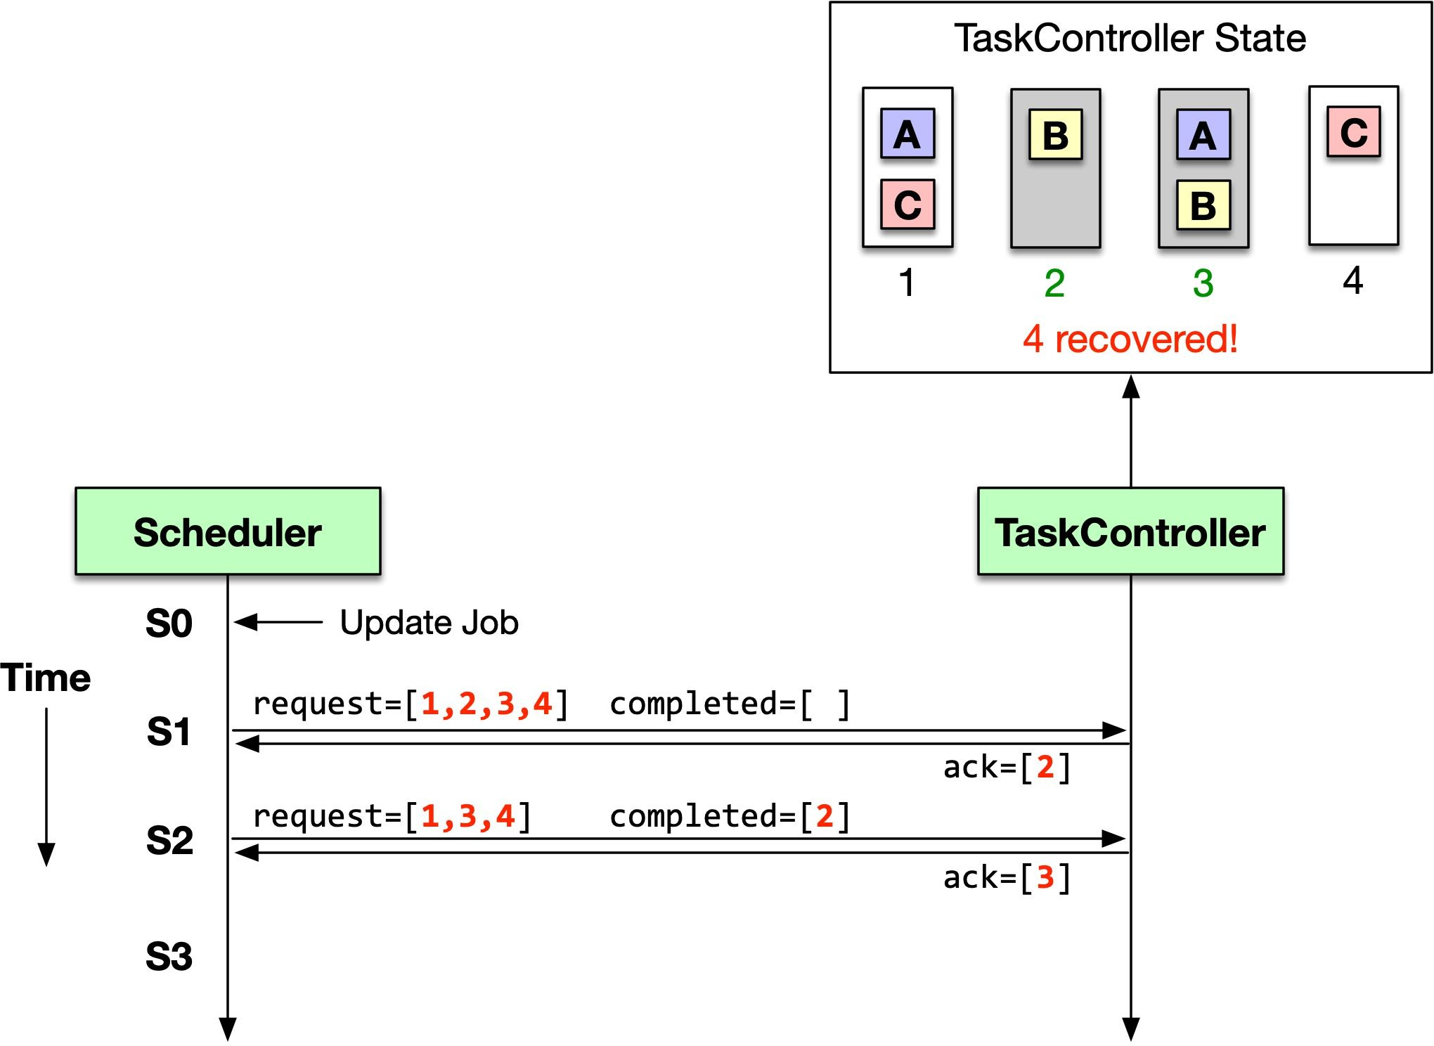
How does Twine collaborate with applications?

Slide 45
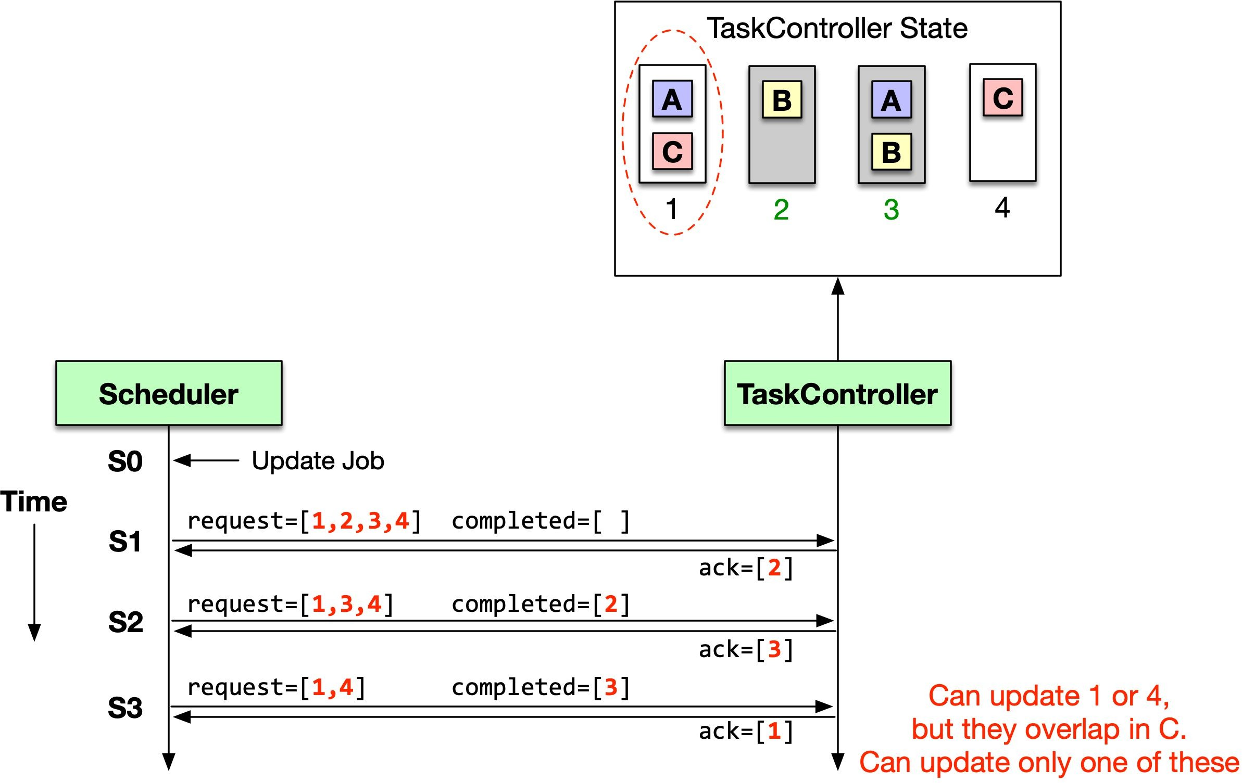
How does Twine collaborate with applications?

Slide 46
What are the challenges with supporting ubiquitous shared infrastructure?
Challenge 1
Approach
Host profiles
Challenge 2
Tasks are not homogenous
Approach
TaskControl API

Slide 47
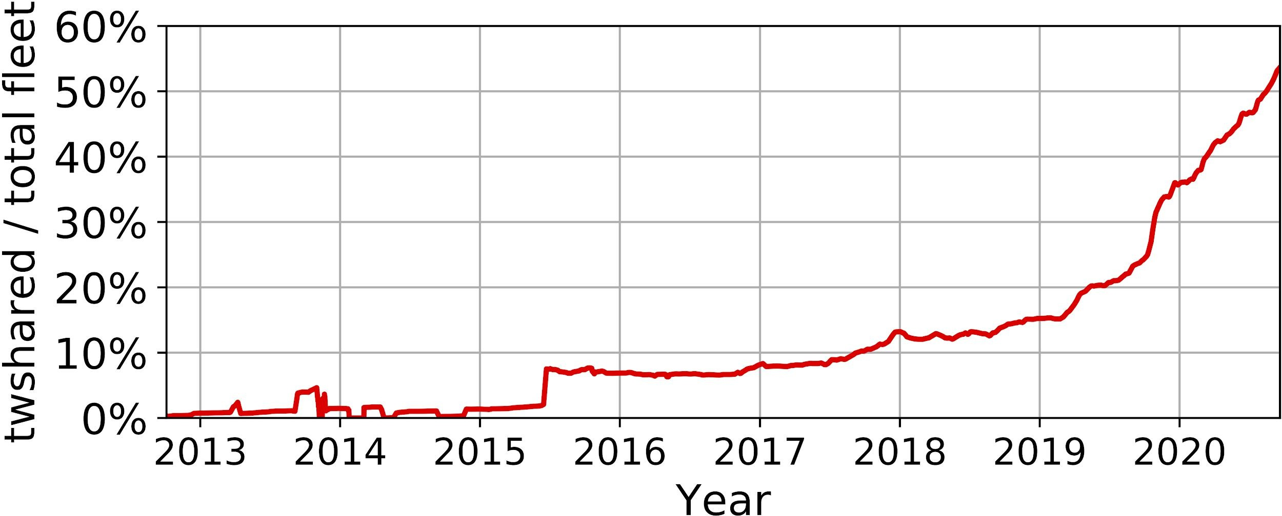




What is our shared infrastructure adoption?
New compute capacity in twshared only
twshared: shared infrastructure for compute
Web fully on twshared
Host profiles created
TaskControl created

Slide 48
How easy is it to migrate onto shared infrastructure?
Case study with PGx: O(100s) services, O(100Ks) machines
800 3
Entitlements, ³ Host profile dense stacking ^{TaskControllers} settings
46
0% to 70% capacity
in twshared in 9 months！

Slide 49
What design decisions did Twine make differently?
Decision 1
Dynamic machine partitioning
over static clusters
Decision 2
Customization in shared infrastructure
over private pools
Decision 3
Small machines
over
big machines

Slide 50
Big machines or small machines?
Big machines
2 CPUs, 20 cores each
256GB RAM
Dedicated NIC
30 machines per rack
Small machines
A small-machine rack vs. a big-machine rack
1 CPU, 18 cores
64GB RAM
4 machines share 1 multi-host NIC
92 machines in a rack
38% more cores
34% less memory

Slide 51
Why use small machines?
Existing large services are optimized to fully utilize whole machines
Resource control historically not mature
Not a public cloud: no external users

Slide 52
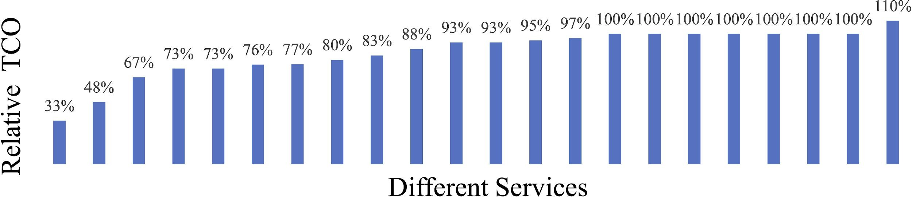
How much do we save by using small machines?
Relative total cost of ownership

Slide 53

18% power savings wide.
17% savings in total cost of ownership.
How much do we save by using small machines?
Relative total cost of ownership
52

Slide 54
What lessons did we learn using small machines?
More work required when working with hardware vendors
Large effort to rearchitect services to fit into less memory
Stacking tasks is less effective

Slide 55
Conclusion
Evolving Twine over the past 10 years
Dynamic machine partitioning
Avoids stranded capacity in isolated clusters and enables fleet-wide optimizations
Customization in shared infrastructure
Support ubiquitous shared infrastructure to improve efficiency without sacrificing workload performance or capability
Small machines
Achieve higher power efficiency globally

Slide 56
Thank you!
Chunqiang Tang, Kenny Yu*, Kaushik Veeraraghavan, Jonathan Kaldor,
Scott Michelson, Thawan Kooburat, Aravind Anbudurai, Matthew Clark, Kabir Gogia, Long Cheng, Ben Christensen, Alex Gartrell, Maxim Khutornenko, Sachin Kulkarni, Marcin Pawlowski, Tuomas Pelkonen, Andre Rodrigues, Rounak Tibrewal,
Vaishnavi Venkatesan, Peter Zhang,
and everyone who contributed to Twine’s development over the past decade.
Contact: kennyyu@fb.com

Slide 57


